Slide 1
Ing. Richard van der Molen
Landstede Education Group
Director location Harderwijk, Netherlands

Slide 2
Professional background
Agricultural engineer
20 years experience as manager in Agro sector
10 years experience as
director of VET institute

Slide 3
12.000 students Vocational Education & Training
9.500 students Secondary School
60 locations
2.600 employees

Slide 5

How to improve employability of young people
How can young people be successful
to get a job and earn a living

Slide 6

5 Key factors

Slide 7

With enthusiasm, motivation and work ethic you can ……………

Slide 8
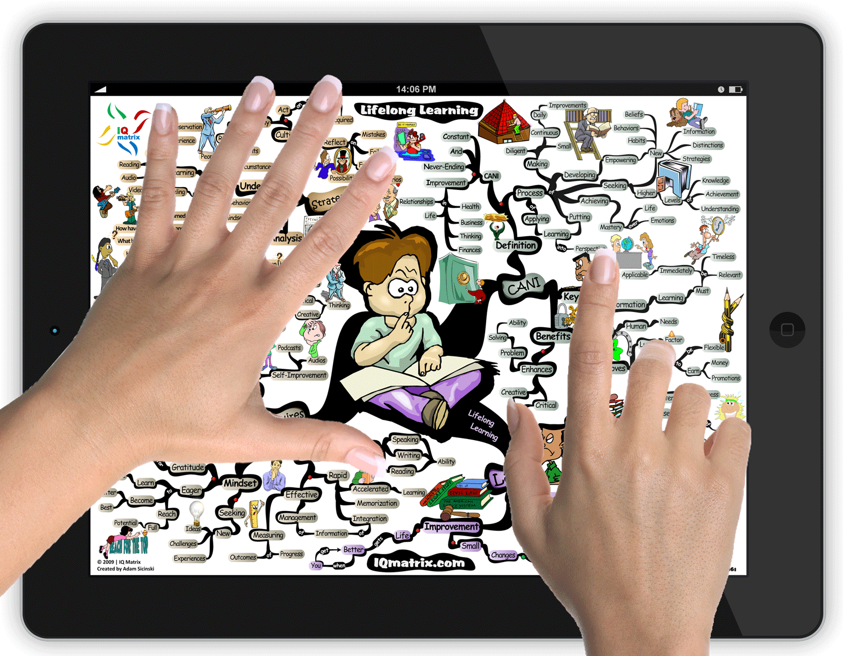

Lifelong learning, develop (your) unique qualities

Slide 9




Build, maintain and use your network in a relevant sector

Slide 10
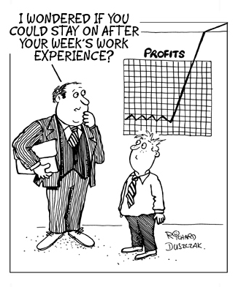

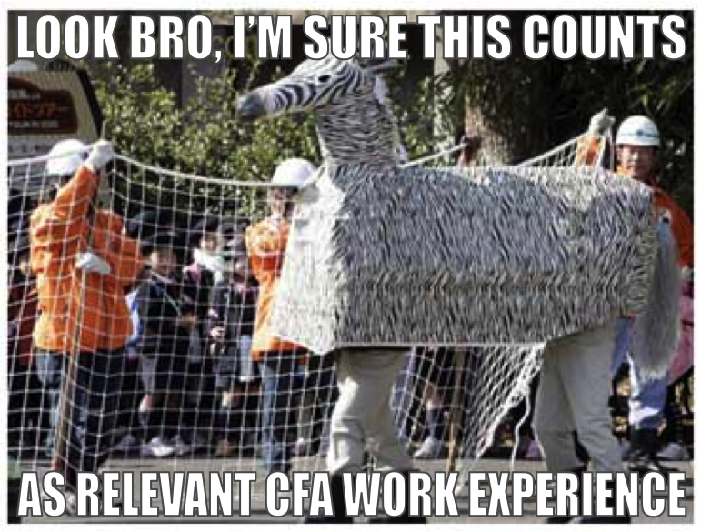
Use opportunities to have (work) experience

Slide 11



Take your chances, if plan A doesn’t work, what’s the next alternative

