Slide 1

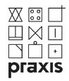
Education Offered by Universities and Enterprises’ Real Needs
Prof. Ing. Ľubomír Šooš, PhD.
Bc. Malcolm Jones
Slovak University of Technology Bratislava,
Faculty of Mechanical Engineering, Slovak Republic.
 | PRAXIS’14 Forum

Slide 2
Content
Introduction (FME STU), Collaboration with industry
Problems of technical education in the Slovak Republic
Tackling / resolving the problems
3.1 Changing the system of university financing
3.2. Study Motivation
4. Conclusion

Slide 3
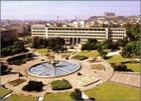
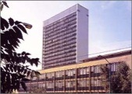
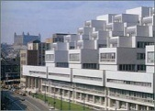
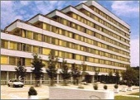
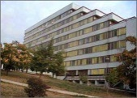
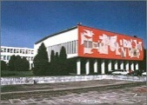
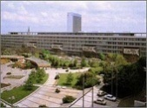
Slovak University of Technology in Bratislava
1937 establishment of M. R. Štefánik Technical University
1939 name into Slovak Technical University
1994 name Slovak University of Technology
Faculties on the STU :
Faculty of Architecture
Faculty of Civil Engineering
Faculty of Chemical and Food Technology
Faculty of Electrical Engineering and Information Technology
Faculty of Informatics and Information Technologies
Faculty of Materials Science and Technology
Faculty of Mechanical Engineering
STU has more than 18 000 students, 5800 Staff

Slide 4
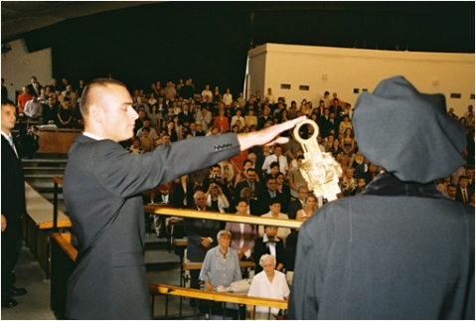
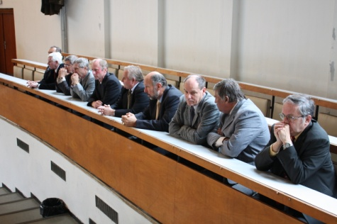
Faculty of Mechanical Engineering
Milestones:
1951 foundation of Faculty of Mechanical Engineering
Today the Faculty of Mechanical Engineering is accredited to provide study in triennial bachelor programs, biyearly master graduate programs, and triennial internal or 5-year external doctoral study covered with the pedagogical staff of more than 160 lecturers from eigth institutes.

Slide 5
COLLABORATION WITH INDUSTRY
Centre of Quality (PSA, VW, KIA, AUDI, ŠKODA)
ÚSETM and AUDI Ingolstadt has collaborated on a project where the Measurement Centre for Automotive Parts was established as a Center of Quality. Production of off-road AUDI vehicles was starting in VW plant, Bratislava in Sept. 2005.

Slide 6
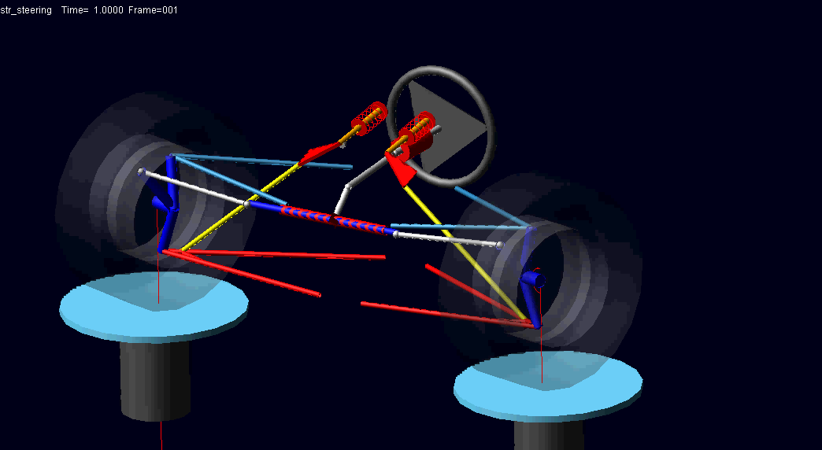
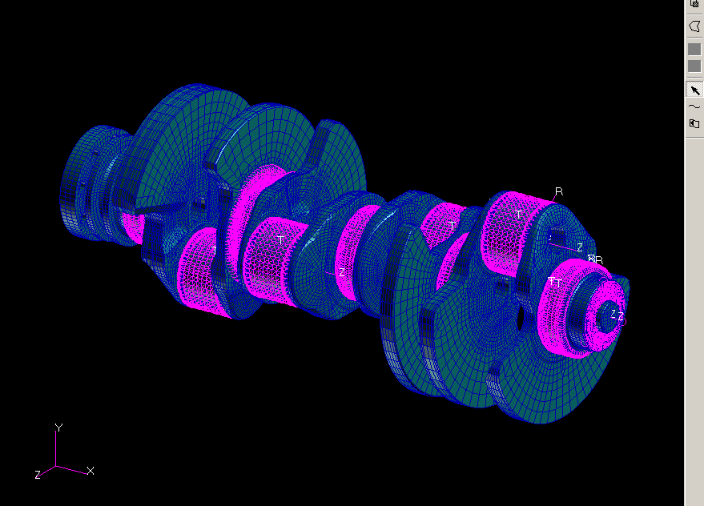
COLLABORATION WITH INDUSTRY
FME cooperates in:
Engineering technologies, production
machines and equipment,
Machines and equipment for chemical,
food and consumer goods industry, for
technics of environment protection,
Thermal power industry, hydraulic and
pneumatic machines and equipment,
Transporting and manipulating
machines and equipment,
Instrumental, information and
automation technics,
Automotive industry,
Applied mechanics and mechatronics
respecting nowadays energy and
environmental challenges.

Slide 7
2. Problems of technical education in the SK
Slovakia is an industrial economy and manufacturing companies need top-class graduates, engineers, designers and researchers in order
to achieve sustainable growth.
We don’t have enough graduates for
Enterprises’ Real Needs
Education is the responsibility of each society or state. In this sense of the meaning we can never be rich enough. So we should ensure we invest our resources effectively in educating young people and investing in the future of our nation.

Slide 8
Where are weaknesses in the system:
- is the education of young people really effective?,
- what is the quality of our graduates like?,
- how are education and industry connected?
- is there really so little money in the system, or is it rather that the system of allocating it is inefficient?’
2. Problems of technical education in the SK
The main reason that companies are interested in co-operating with universities is twofold:
- access to applied research;
- the quality of the graduates.

Slide 9
Unfortunately, in the last few years we have seen a divergence between the promises and reality.
Financial resources are allocated ineffectively by the state, three times over:
- firstly the Ministry of Education gives money to schools which educate an army of unemployed,
. secondly the Ministry of Labour and Social Affairs is given resources to support the unemployed graduates,
- thirdly, money is then provided for retraining these unemployed graduates.
2. Problems of technical education in the SK

Slide 10
Student numbers quality of education in technical subjects such as maths and physics in secondary schools is inadequate.
- motivation of the student s for studying at technical universities is low
- technical education in our society is undervalued
University study
- more than 70% of graduates of secundary school leavers want to study at university.
- more than 50% of students in their first year of undergraduate study find the courses too difficult and fail,
- more than 90% of first degree students continue to the second degree level
- graduates (Bc.) who after completing their first degree don’t have enough necessary practical experience
3. Tackling / resolving the problems

Slide 11
      Figure: How the Three Year Dual (France and SK) Certification Accreditation Proposal
      It does not meet the requirements of the educational process, [1].
Source: D. SCHWEIZER, Vysokoškoláci do praxe - predstava PSA. [3]

Slide 12
      Figure: Schema of Professional 4 year Bachelor Degree

Slide 13
  3.1 Changing the system of university financing
Financial support is based on the results of scientific research undertaken, the level of success in winning grants, publications, the number of international students, and the overall number of students attending the institution.
The most important of these criteria ( more 60%), is the number of students on courses.
System doesn’t have any criterium regarding unemployed graduates. (less that 1.6 %)
Universities were to be divided into 3 groups – universities, high schools, and specialised high schools, These 3 groups were to receive different amounts of finance, with up to 70% difference between
In SR Universities are divided in three kinds (State, Public, Private ) State universities receive money from the state. Public universities can decide per capita from the state, or to charge student fees. Private universities can take maney from the goverment but charge student fees too.
By type of universities: different resource requirements are needed to teach economics, philosophy, pedagogy or theology, for instance, compared to the those needed to educate students in technical subjects, pure sciences, medicine, or agronomy,

Slide 14
3.2. Study Motivation
Possibility of motivation
Idea of our goverment - motivating stipend for program of study in demand.
Our proposal - system of bridging loans. This system is beneficial, especially for students from socially deprived families, as students would be eligible to receive a loan for their study and, after completing their studies, would repay the loan. How much, and over what period of time, would be calculated according to the nature of the student’s subsequent employment.

Slide 15
  4. Matching businesses with students during their study
Next we present two interesting projects which may offer one possible solution to the problems of ensuring the relevance of student education and training:
Universities – Engines of the Knowledge Society (hereinafter MVS);
Postgraduate Research Centre project (PRC).
  Universities – Engines of the Knowledge Society (MVS)
The first of these projects, MVS, is designed to enhance the relevance and quality of short and long term student internships in companies.
The aim is to identify those university study programmes which are in greatest demand by businesses enterprises, in order to be able to provide students not only with relevant theoretical knowledge, but also with the practical experience through direct contact with the advanced technologies being used in practice in the most dynamic sectors of the employment market. All informations of businesses and work areas in which companies offer the best collaboration is available on the website www.vysokoskolacidopraxe.sk.

Slide 16
      Figure: Contractual arrangement for individual training centres,
Source: Vysoké školy ako motory rozvoja vedomostnej spoločnosti [4]

Slide 17
Postgraduate Research Centre:
Selecting the most promising, talented and motivated graduates
Securing employment for graduates
Continue working for the company - research role, greater added innovation
Accelerated adaptation and performance on the basis of previous experience and development
Further development of competencies
Part of the cost of subsidies covered by Ministry of Labour Social Affairs and the Family

Slide 18
      Figure: Diagram of postgraduate research centre
Source: Ľ.Šooš, “Applied research - the best bridge between school and industry through post graduate research centre” [5]

Slide 20
      Figure: The planned network of postgraduate research centres

Slide 21
      Figure: The potential links for the postgraduate research centres

Slide 22
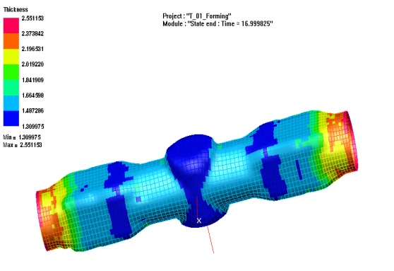
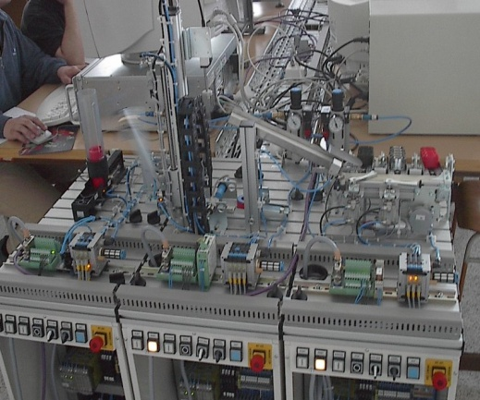
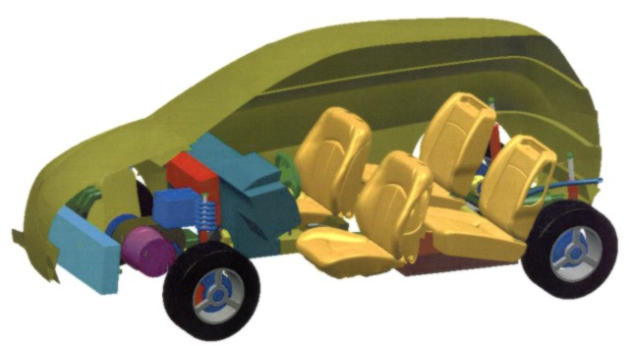
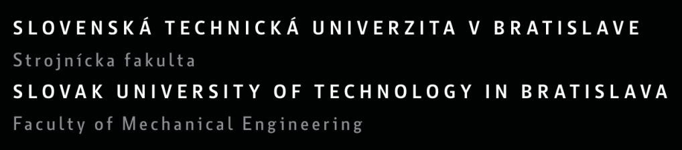
Thank you for attention
prof. Ing. Ľubomír Šooš, PhD.,
Dean of the FME, STU in Bratislava,
Nam. slobody 17, 812 31 Bratislava 1, Slovak Republic,
lubomir.soos@stuba.sk, www.sjf.stuba.sk

