Slide 1

Virtual Worlds in Supporting the Communities of Practices
Rosa Reis, Ricardo Almeida, Nuno Escudeiro, Paula Escudeiro
Departamento de Engenharia Informática
PORTUGAL
September 25&26 ,2014 – Genova (Italy)
Notes:
My presentation consists of the explanation of a model to help us structure our ideas to build a collaborative virtual environment under the platforms with OpenSim, Second Life, Active Worlds
So, I Structured presentation in four main points.
O prupose, o model, explain the process and finaly I explain about the evaluation model. how can I evaluate the environment?

Slide 2
Tips to be Covered
Purpose
The Communities of Pratice
Virtual Worlds
Virtual Worlds in supporting to communities of pratice
Model and Case Study
Conclusion

Slide 3
Purpose
Describe a model for knowledge sharing in virtual communities of practice in virtual worlds, addressing some potential advantages when used to supporting communities of practice.
Purpose | CoP | Virtual Worlds | Virtual World and CoP | Model| Conclusion
Notes:
Ler o acetato.

Slide 4
The CoP
Groups of people who share interests, problem sets by a particular topic, deepening their knowledge and expertise in specific areas, through interactions each other;
It is also important to remember that CoP is a strategy or approach. It is a way of working together with various stakeholders to achieve common agreed upon goals in a manner that can be more beneficial compared to each stakeholder working in their own silos.
Purpose | CoP | Virtual Worlds | Virtual World and CoP | Model| Conclusion
Notes:
This model covers all phases of software development, and uses the model of evolutionary prototyping. That is,

Slide 5
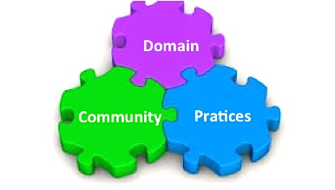
The CoP
Structural elements of CoPs
Domain: has an identity defined by a shared domain of interest. Membership therefore implies a commitment to the domain, and a shared competence that distinguishes members from other people.
Community: Within their domain of interest, members engage in joint activities and discussions, help each other, and share information.
Practice: Key to the paradigm is the fact that members of a community of practice are practitioners [our emphasis]. They develop a shared repertoire of resources: experiences, stories, tools, ways of addressing recurring problems, namely a shared practice. This takes time and sustained interaction.
Purpose | CoP | Virtual Worlds | Virtual World and CoP | Model| Conclusion
Notes:
Domain : Members value their collective competence and learn from each other, even though few people outside the group may value or even recognize their expertise
Community: They build relationships that enable them to learn from each other.
It is the combination of these three elements that constitutes a community of practice. And it is by developing these three elements in parallel that one cultivates such a community (Wenger, 1998).

Slide 6
The Virtual World (VW)
A virtual world is a simulated persistent space based on the interaction by computer, inhabited by several users, who are represented by iconic images called avatars, who can communicate with each other’s and the world in a synchronized way (Reis, 2011).
Purpose | CoP | Virtual Worlds | Virtual World and CoP | Model| Conclusion

Slide 7
The Virtual World (VW)
Characteristics of the virtual world:
Shared space
Immersion and Interactivity
Persistence
Immediacy
Socialization:
Purpose | CoP | Virtual Worlds | Virtual World and CoP | Model | Conclusion
Notes:
These characteristics have contributed to represent in virtual world the different categories of information by means of three-dimensional objects, and thus, it is possible to develop a world similar to the real life

Slide 8
The Virtual World (VW)
Social Virtual Worlds
are oriented by socialization and haven’t pre-defined rules.
Allow experiences being more realistic.
have several technologies into a single platform: audio, video, webcam, text and voice chat (VOIP), graphical tools, scripting, web browser and of course, avatars – the user’s projection in the world.
Active Worlds
Second life
Wonderland
Cobalt (croquet)
OpenSim
Lively (Google)
Purpose | CoP | Virtual Worlds | Virtual World and CoP | Model | Conclusion
Notes:
The objectives of members shall live and prosper by using the social practices that they can find in off-line environments
The users do not necessarily win or play a game, but socialize with others users
Combining these tools and the social aspects, it opens up the way for new perspectives, new ideas that will gradually allow new applications to be used more or less related to real economics.

Slide 9
VW and CoP
Why
  allow to support the collaboration and cooperation between the individuals of practice community
  the community members can build objects in together performing simulations or participating in them in order to obtain an education through digital experiences
  allows the development of digital interactions between community members, they can construct objects of knowledge can make a digital representation of abstract concepts and can share experiences and practices in an environment that allows many actions
  the presence of different technologies( audio, text, video, 3D) allows the people belonging to different cultural systems can develop relationships;
Purpose | CoP | Virtual Worlds | Virtual World and CoP | Model | Conclusion
Notes:
So we propuse a model for implementing a CoP Under Virtual WORLD PLATFORMS

Slide 10
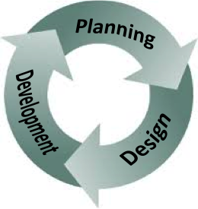
The Model - Phases
A model for implementing a CoP Under Virtual WORLD PLATFORMS
identify the domain of community of practice e specify the type of community, i.e. it is private or public. An important feature is the allocation of roles to participants in a community of practice
based on the scenarios
describe the structure of the community of practice.
Purpose | CoP | Virtual Worlds | Virtual World and CoP | Model | Conclusion
Notes:
Planning - In this phase it is important to develop the concept of community, i.e. what is the subject, the activities that will be developed, the members and their roles in the community, what are benefits, financing, among others. The roles : coordinator, facilitator/mediator, technical support, and professional (expert) or other paper
Design - We suggest divide the space in three subspaces: knowledge space, discussion space and activities space.
Development - To describe the scenarios, we propose the use the storyboards. The storyboards creation is a complement of the interface objects description. Its aim is to provide a global view of the CoP giving a clear idea of the speech, plot and other instructional questions

Slide 11
The Model
A Community of Practice Praxis
This CoP has as objective to support work of the group of Paradigms of Cooperation between the Worlds of Education and Labour and to centralize discussions and resources.
Our Environment must allow members interact with the CoP, create contents; realize meetings and events in space virtual.
to have a narrowly defined thematic, identify the audience, purpose, goals, vision for the community, plan activities to help grow and sustain the community, group process and roles that will support the community’s goals.
Purpose | CoP | Virtual Worlds | Virtual World and CoP | Model | Conclusion

Slide 12
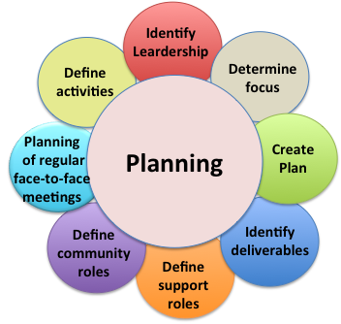
The Model
A Community of Practice Praxis – Conception
We held regular brainstorming sessions for collecting ideas. At the end a design document was delivered. The content of the document reflected the work done by development team.
Purpose | CoP | Virtual Worlds | Virtual World and CoP | Model | Conclusion

Slide 13
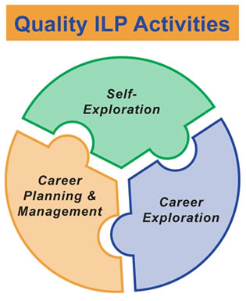
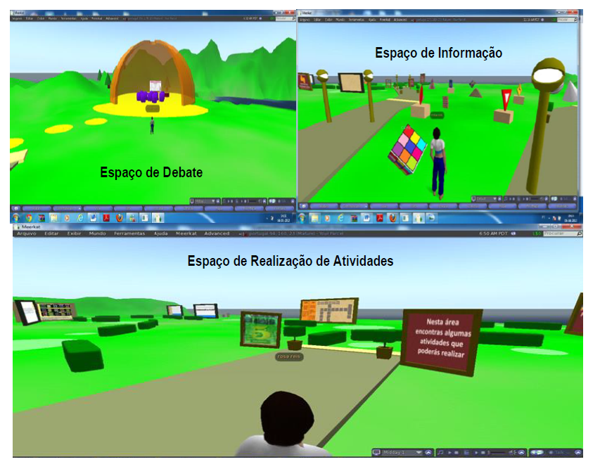
The Model
A Community of Practice Praxis – Implementation
implemented in OpenSim platform.
divided the space into three distinct areas
Space of Debate
Space of Information
Spaces of Activities
Purpose | CoP | Virtual Worlds | Virtual World and CoP | Model | Conclusion
Notes:
We decided to separate our space into different areas because an effective approach to community facilitation involves creating a predictable “rhythm” that sets an expectation around how and when to participate in the community. A “sense of place” is created in the minds of community members through an integrated, thoughtful combination of face-to-face meetings, live online events, and collaboration over time within a persistent virtual environment

Slide 14
The Model
Resume:
The structure of our Cop in OpenSim was developed according to certain key principles:
  Provide a shared context to communicate and share information, stories, and personal experiences in a way that builds understanding and insight.
  Enable dialogue between members to explore new possibilities, solve challenging problems, and create new, mutually beneficial opportunities
  Introduce collaborative processes to encourage the free flow of ideas and exchange of information.
Purpose | CoP | Virtual Worlds | Virtual World and CoP | Model | Conclusion

Slide 15
Conclusion
To overcome distances and develop collaborative work, we can use environments that enhance the productivity and satisfaction of its members.
users CoP can feel the sense of place and presence of other individuals,
users CoP can communicate through of chat, voice;
it is possible to create content targeted to different areas, such as simulations, problems resolution, computer programming and so on; the members, by means of their avatars, can explore, interact with each others and modify the world.
Final,
    in our perspective, the virtual worlds can allow develop CoP informally; Schlemmer (2008, 2009) argues that virtual tools can be used to develop characteristics of communities, such as emotion, the meaning of membership, collaboration and cooperation.
    we agree with Figueredo, 2006 when he states that “the communities we create must leave the space to stimulate the imagination because "who participates without dreaming hardly will be creative".
Purpose | CoP | Virtual Worlds | Virtual World and CoP | Model | Conclusion

Slide 16
THANK YOU!
OBRIGADA!
Rosa Reis, Ricardo Almeida, Nuno Escudeiro, Paula Escudeiro
Departamento de Engenharia Informática
PORTUGAL
September 25&26 ,2014 – Genova (Italy)

