Slide 1

- event
25.09.14
INNOVATION IN TEACHING AND LEARNING IN HIGHER EDUCATION WITH 3D VIRTUAL TECHNOLOGIES
M. Travassos Valdez¹, C. Machado Ferreira² and Fernando Maciel Barbosa ³
¹ Departamento de Engenharia Eletrotécnica
Instituto Superior de Engenharia Coimbra (IPC/ISEC)
² Instituto Superior de Engenharia Coimbra (IPC/ISEC) e INESC Coimbra
³Faculdade de Engenharia da Universidade do Porto (FEUP) e INESC TEC

Slide 2
Introduction
Main project objectives:
Improve vocational training curricular units of "Electrical Engineering“
Create interactive learning tools for:
  Circuit Theory
  Analysis of Electric Circuits
1

Slide 3
Introduction
Main target groups
  Students of Theory and Analysis of electrical circuits in curricular units of “Electrical Engineering”
  Teachers and trainers in vocational education
  Individual learners
  Adult education centres
2

Slide 4
Introduction
Possibility of using Virtual Reality Systems (VRS)
Users can interact with images and visualize objects from different angles
Importance of Virtual Reality Systems in education
Development of educational software varied for different themes, providing a continuous improvement in the interaction of information
Use of VRS techniques for distance education
Strengthening of the processes of teaching and learning without face-to-face interaction, with the knowledge to be transmitted in part or as a whole using the technology
New forms of learning occur by adding greater dynamism of the information, taking a vital role in education
3

Slide 5
Introduction
Simulation of reality
The simulation is an imitation of a real-world system
The system transforms and adapts itself, creating new situations for the user
Virtual reality allows the simulation of real world experiences, saving time and money and allows to achieve goals that often would not be so easily achieved
Concept
Interactivity in the virtual environment is the ability to give instructions to the system through actions performed on it and its objects
The labour market requires an investment in new skills and knowledge so that professionals can operate the equipment and working tools, successfully and with quality
4

Slide 6
Simulations - Educational Strategies
The proposed system – basic principles
The tool for teaching Circuit Theory – a specific domain
Application of Virtual Reality Systems, creating interactive and animated virtual worlds
Simple interface and accessible to non-programmers
Design of interactive learning tools for analysing electrical circuits, to understand the relationship between the physical concepts of an electrical circuit
5

Slide 7
Simulations - Educational Strategies
Interactive methods - teaching and learning
The visualization and manipulation of practical work in the laboratory offers students the opportunity to understand the processes
It helps students to better distinguish the procedures, training them to interact with the equipment
Planning
Design and development model
CONTINUOUS EVALUATION
Design
Development
6

Slide 8
Educational Software Model
Creation of three-dimensional models with
3Ds Max
Reduction of the size of the 3D objects with VizUp
Export of objects to WireFusion, where some interactivity is added
Production of interactive contents using Dreamweaver (HTML5, CSS3 and Javascript) and the introduction of presentations on the web as offline presentations
9

Slide 9
Educational Software development cycle
3Ds Max
VizUp
WireFusion
Dreamweaver
Web
9

Slide 10
The cenario
Referenced objects merge in the scene
3Ds Max
9

Slide 11
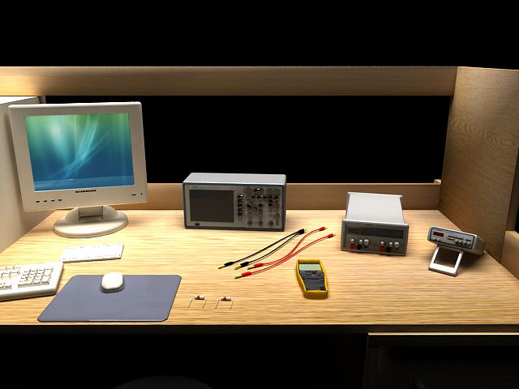
Lab scenarios
Lab scenarios (3Ds Max)
Layout of the workbench and the desired equipment
10

Slide 12
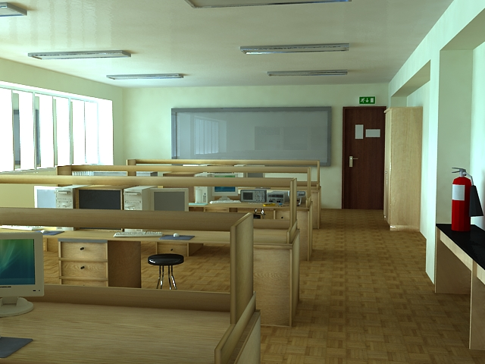
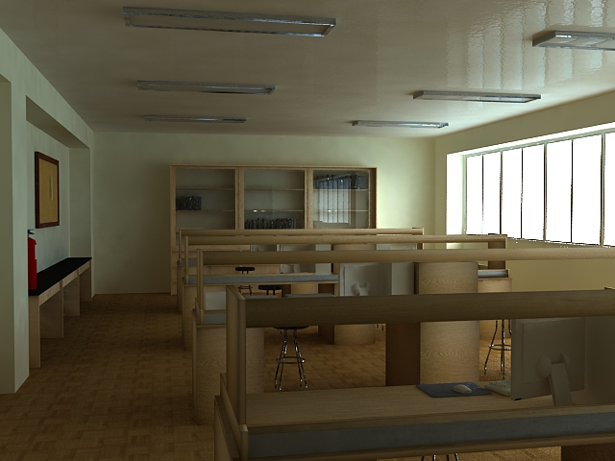
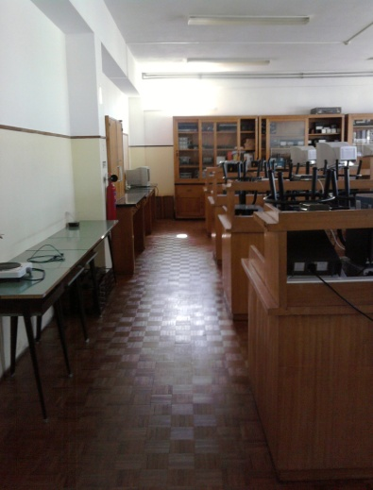
Lab scenarios
Laboratory scene in 3Ds Max for Virtual Electric MAnual-VEMA
Real lab
scene
11

Slide 13
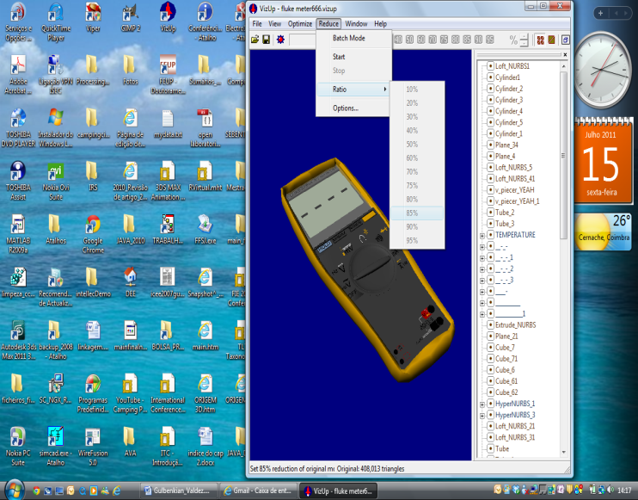
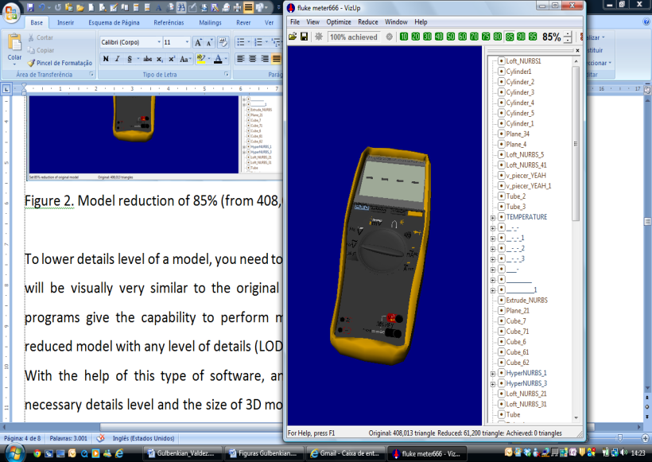
Reducing the number of polygons - VizUp
With VizUp it is possible to obtain a polygonal reduction and optimization of a system that provides a reduction in the number of polygons in a complex 3D model and optimizes its geometry
12

Slide 14
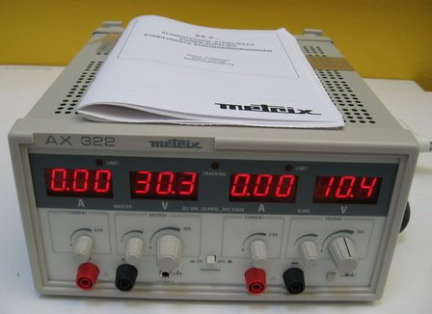
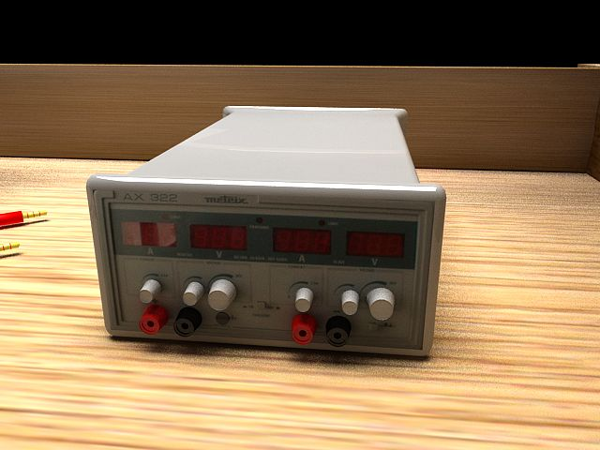
Reducing the number of polygons - VizUp
Power supply-real image
Power supply in 3Ds Max using VizUp
13

Slide 15
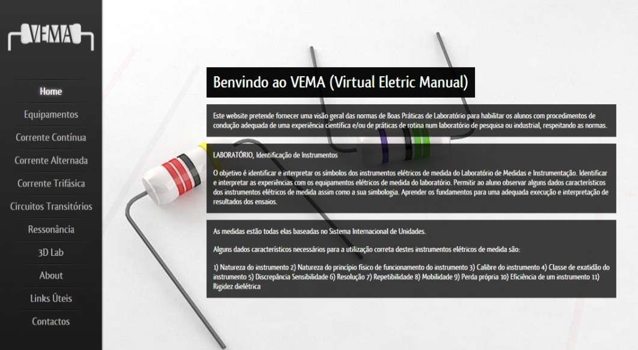
Virtual desktop Prototype Electric MAnual - VEMA
Home page of VEMA
NO BROWSER PLUG-IN IS REQUIRED TO VIEW PRESENTATIONS
WireFusion web player is a Java applet which is downloaded to the user's browser, as well as other files on the web server, using the HTTP protocol
14

Slide 16
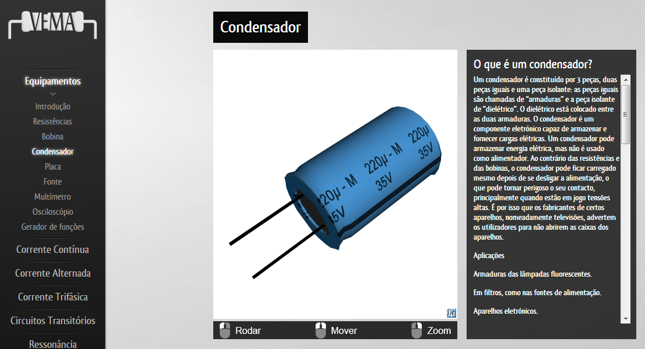
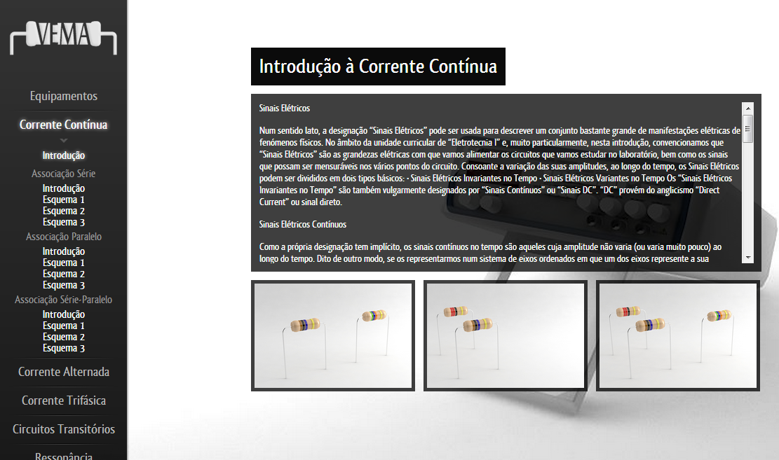
Virtual desktop Prototype Electric MAnual - VEMA
Layout of the equipment
Use cases
Direct current, Introduction
15

Slide 17
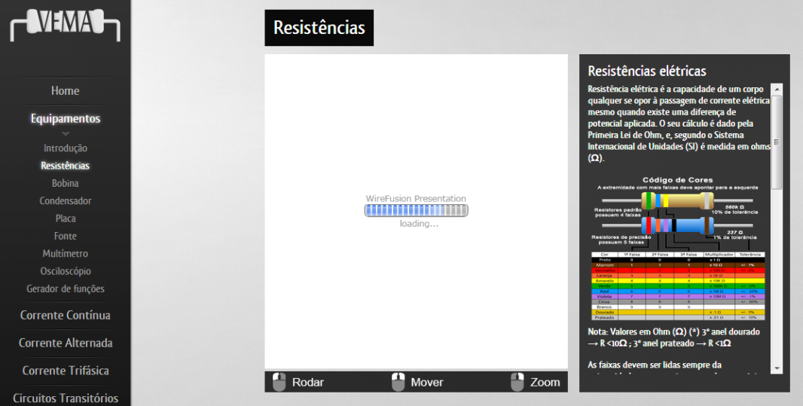
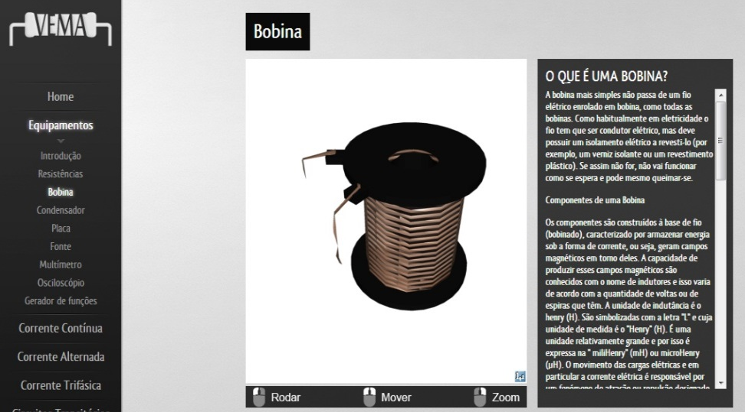
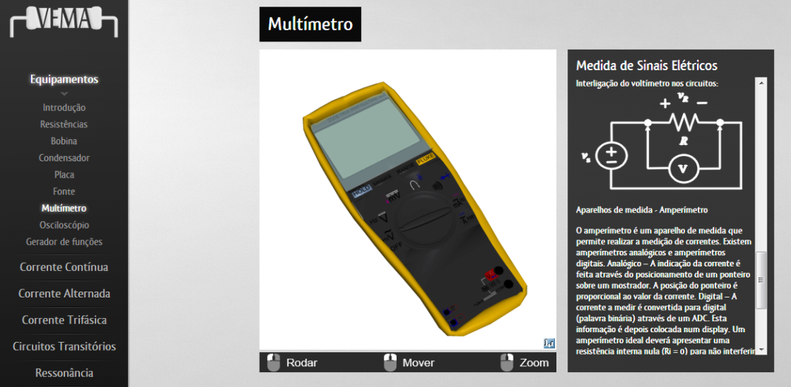
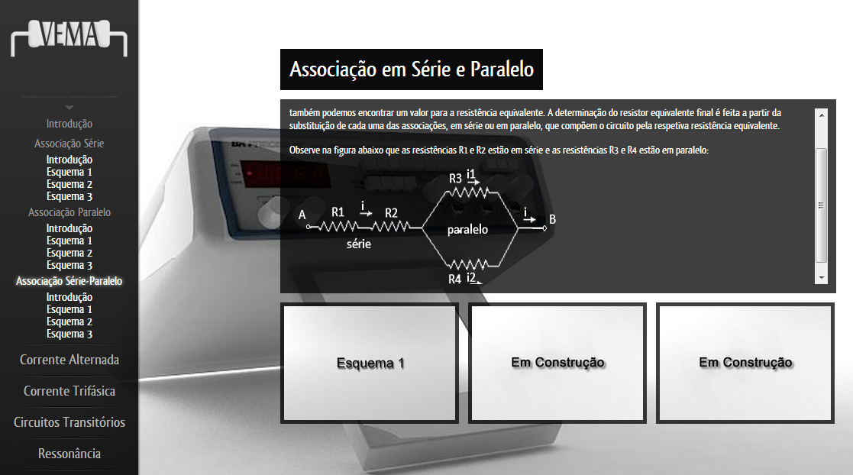
Virtual desktop Prototype Electric MAnual - VEMA
Menus developed for equipment and simulated circuits
16

Slide 18
Virtual desktop Prototype Electric MAnual - VEMA
The aim is to:
    build a 3D lab environment in which the components can be seen and manipulated
    give students an overview of electrical circuits and the corresponding equipment and provide an adapted environment
    allow students to contact and train with the virtual environment and be quickly involved in minor electrical projects using this virtual lab
17

Slide 19
Discussion
Discussion:
    Theories of education and cognitive science support the role of VR as a training tool
    Interaction with an environment or a process is fundamental to the learning process
    Students learn through their experience of the world in a process of construction of knowledge
    VR can be a useful tool because it confirms that knowledge must be acquired through contextualized activities in authentic situations
    Students acquire more information if the physical senses are more involved in the learning process
18

Slide 20
Expectations
The work intends to:
    develop a system of lessons on Circuit Theory (specific domain)
    associate this tool with current teaching techniques, improving the teaching methods
    use the circuit simulator as a student-centered educational tool
    make use of techniques of Virtual Reality systems for users who have no previous knowledge on the subject
    create a low-cost tool to be used as a support in the lab or remotely through an educational license
19

Slide 21
Conclusions and future work
As the desktop Virtual Reality applications are reusable, and easily updated, they potentially allow a reduction in the budgets of preparation and training
It presents itself as a very attractive option both for education and industry because it is possible to distribute them on the web
The VR desktop applications create new opportunities for each student to get more actively involved in his/her own learning process
20

Slide 22
Conclusions and future work
The VEMA prototype contributes to the construction of new virtual environments, benefiting the communication between teachers and students
VEMA is a E-learning platform that promotes interaction and experimentation through technological resources
VEMA consists of experimental interactive scenes
VEMA is not seen as a replacement of the traditional teaching methods, but as an additional resource
21

Slide 23
- event
25.09.14
INNOVATION IN TEACHING AND LEARNING IN HIGHER EDUCATION WITH 3D VIRTUAL TECHNOLOGIES
Fernando Maciel Barbosa
Faculdade de Engenharia da Universidade do Porto (FEUP) e INESC TEC

Slide 24


