Slide 1
Internship Implementation Models and Student Choices
Ilmārs Slaidiņš, Laura Vītola, Una Vorma
PRAXIS’14 Forum, 25-26.09.2014, Genova

Slide 2

Introduction
“By 2020, an EU average of at least 20% of higher education graduates should have had a period of higher education-related study or training (including work placements) abroad, representing a minimum of 15 ECTS credits or lasting a minimum of three months”
  Council of EU, “Council conclusions on a benchmark for learning mobility” 2011.

Slide 3
Mapping the field
Winter and spring of 2012 – how can we start?
Terminology for Internships: “work placement”, “industrial placement”, “practical placement”, “practice”
Definition of concepts Project and Internship
Stakeholders: Students, HEI, Companies
Different roles and interests
3 Questionnaires

Slide 4
Questionnaires
HEIs - How Projects and Internships are organized?
Companies – What is your offer in the field of Projects and Internship?
Students - What are your wishes and what would you like to achieve from PI?
30 questions for HEIs and 20 for Companies and Students

Slide 5
Questions
Project or internship or both, part-time or full-time, remuneration, governance;
Individual or team based. For the Team: national, international, real or virtual, small team (<4), medium (4-8), large (more than 8);
Location: home institution, national company, abroad (international team), real or virtual;
Project/Internship option: Project, Internship, Project in Internship, Design Project , etc.;
Duration, ECTS and timing (semester, included in the study program before or after graduation).

Slide 6
Survey
Betta version tested with partners 03-04.2012
Survey: September 2012 - October 2013
HEIs – 77 responses, Companies – 68, Students -1804
Responses not evenly covering all fields and countries
Statistical and Qualitative Analysis

Slide 7
HEI – 77 responses
Engineering (38%), Computing and IT (34%) and Business (12%)
Project courses (54%) or combined with the internship (26%) – total 80%
At national level (77 %) and compulsory (65%)
1-6 months and 6 to10 ECTS or more
Projects unpaid (95%), Internship - mostly paid
Comments on how PI courses are organized!

Slide 8
Companies - 68
Computing and IT (44%) and Engineering (37%)
Internships (85%) and projects (60%)
Teams up to 4 students,
1 to 6 months or more

Slide 9
Students - 1800
Engineering (41%) and Computing and IT (37%)
Spain (433), Slovenia (291), Cyprus (183), Portugal (126), Belgium (113), Finland (91)
Prefer internship in a team (75%) and international team (58%), virtual teamwork - 5%
Most important: subject/topic, company and salary, but it can differ depending on situation

Slide 10
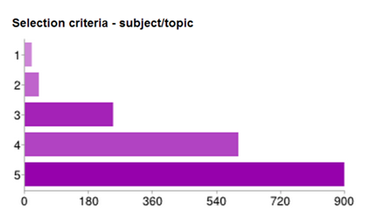
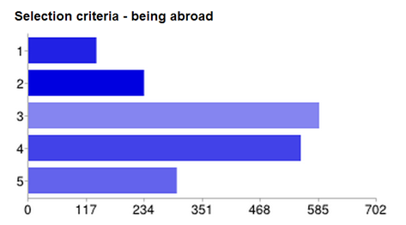
Dispersion of ranking

Slide 11
What are the main benefits students are expecting from P/I?
71% Getting experience in the field of my interest
65% Working in a professional setting
64% Chance to be employed by the company/institution offering P/I
59% Working on a real-world non-academic assignment
50% Getting to know real working conditions
40% Working in team
22% Autonomy

Slide 12
Implementation models
From Comments in HEI Questionnaires
Stages for Internships:
  finding the internship place and official arrangements;
  supervision of the internship;
  reporting and evaluation.
Stages for Projects:
  selection of the project topic and project planning;
  work on the project, project management and supervision;
  project results, reporting and evaluation.
Best practice could be indicated and shared !

Slide 13
Conclusion
71% of students are looking for experience in the field of their interest.
Project/Internship course offers by HEIs and companies mainly comply with student wishes, but not fully.
Companies offer more internship places and fewer projects than students want.
Students prefer teamwork, but it is not fully supported by companies and HEIs.
58% of students prefer international teamwork, but companies offer it in 43% and HEIs just in 17% cases

Slide 14
Questions?

