Slide 1



Enhancing Engineering Education through Academia Industry Cooperation at the Master’s Degree Level
Fernando Maciel Barbosa – FEUP Porto – fmb@fe.up.pt
- event
22.09.2014
22.09.2014

Slide 2

- event
22.09.2014
Chapter
Enhancing Engineering Education through Academia Industry Cooperation at the Master’s Degree Level
C. Machado Ferreira - IPC/ISEC and INESC Coimbra, Portugal cmacfer@isec.pt
F. P. Maciel Barbosa – FEUP and INESC TEC, Porto, Portugal
fmb@fe.up.pt
Maria João M. Martins - Academia Militar (AM), Lisboa, Portugal mariajoaomartins2@gmail.com
Fernando Lopes - IPC/ISEC and IT ‑ Coimbra, Portugal
flopes@isec.pt
Inácio Fonseca – IPC/ISEC Coimbra, Portugal
inacio@isec.pt

Slide 3



- event
22.09.2014
Introduction
Electrical Engineering Education at the Master’s Degree Level is presented through three perspectives of collaborative projects involving industry and academia
The presented perspectives originate from three Portuguese Higher Education Institutions:
Military Academy ‒ Military Electrical Engineering Master
Coimbra Institute of Engineering ‒ Automation and Communications in Energy Systems Master
Faculty of Engineering of the University of Porto ‒ Electrical and Computers Engineering Master

Slide 4
- event
22.09.2014
Introduction
The three degree programs objectives, competences, structure and organization, follow the Portuguese Law, the main principles of the Bologna Process and are in accordance with the Tuning project’s recommendations
The cooperation between academia and industry produces interesting outcomes, bringing effective improvements into electrical engineering education
The described collaborative projects share the following goals:
enhancing the learning experience of students
creation and dissemination of applied engineering knowledge
contributing for the generation of high value in industry and institutions
pursuing the qualification of individuals with a high level of scientific, technical and cultural education

Slide 5
- event
22.09.2014
Introduction
Engineers are increasingly engaged in international projects, including service in multinational teams at different points around the globe, collaborating in a real-time common projects
Effective collaboration requires not only the ability of participants to communicate in a common language, but also the assurance of a common level of technical understanding
To meet these new challenges the students are incentivise to prepare their dissertations and projects in the industry or to get an internship
From the engineering perspective, the dissertations in an industrial environment or the internships are vital in order to integrate the students in the modern and international engineering world, namely if the internship is abroad

Slide 6
- event
22.09.2014
Higher Education System in Portugal
From the late 1970s Portugal has a binary Higher Education system, with Universities and Polytechnics
In March 2006 the government published the long awaited law reforming the Portuguese HE degree system in accordance with the Bologna process, introducing namely the ECTS
The new three-cycle degree system is:
Licenciatura of a duration of 3 years of full-time study (180 ECTS), offered both by Universities and Polytechnics
Mestrado (M.Sc.), of a 2 year duration (120 ECTS), of which at least 35% (42 ECTS) are dedicated to work on a dissertation/project/internship
Doutoramento (Ph.D.), of which the first year can consist of course modules

Slide 7
- event
22.09.2014
Higher Education System in Portugal
The Mestrado (Master Course) can be conferred both by Universities and Polytechnics
The law allows also Universities, not Polytechnics, to offer Integrated Master programs of 300 ECTS in areas where, according to EU rules or to established tradition in the EU, access to a profession requires such a length of studies (Medicine, Architecture and in the more traditional Engineering areas)
The Doutoramento can only be conferred by Universities, subject to the requirement that the institutions have a consistent and high-quality R&D track-record in the area of speciality
Agency for Assessment and Accreditation of Higher Education (“A3ES”): the mission of A3ES is to contribute to improving the quality of Portuguese higher education, through the assessment and accreditation of higher education institutions and their study programmes, and to ensure the integration of Portugal in the European quality assurance system of higher education

Slide 8
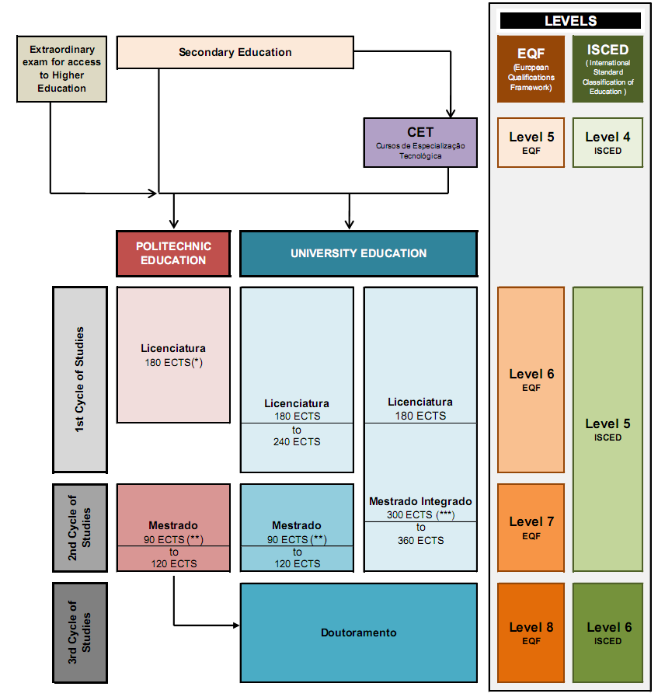
- event
22.09.2014
Higher Education System in Portugal

Slide 9

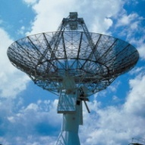
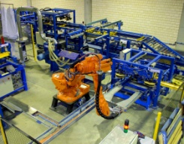
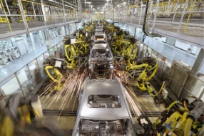
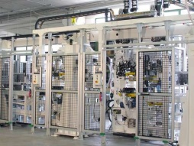
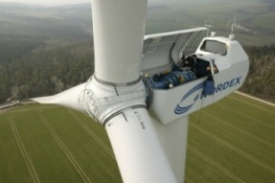
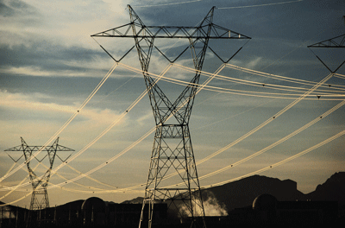

- event
22.09.2014
Faculty of Engineering of the University of Porto
Electrical and Computers Engineering Master
The Faculty of Engineering of the University of Porto (FEUP) offers an Integrated Master in Electrical and Computer Engineering that lasts five years and is organized in three major specialization areas:
Telecommunications
Automation
Energy

Slide 10
- event
22.09.2014
Faculty of Engineering of the University of Porto
Electrical and Computers Engineering Master
After the completion of the first three years of the course (180 ECTS) a diploma in Electrical and Computer Engineering Sciences will be awarded
The branches of specialization all have the same 252 ECTS syllabus covering compulsory curricular units, a dissertation with 30 ECTS and 48 ECTS distributed by elective curricular units
In each semester to all curricular units totalize 30 ECTS (each ECTS corresponds, on average, to 27 hours of overall student work)
The dissertation and/or the internship were introduced at FEUP with the Bologna reform in 2006
At FEUP the students are very motivated for dissertation developed in an industrial environment or internship work (significant problem is to get enough projects in industrial environment or internships for all the students, approximately 500 students)

Slide 11
- event
22.09.2014
Faculty of Engineering of the University of Porto
Electrical and Computers Engineering Master
At FEUP, around 40% of dissertations/internships are undertaken in companies and within mobility programmes, around 4%, mainly within the ERASMUS Programme
With the internships students can also gain practical experience, foreign language skills and cross-cultural competences if the internship takes place abroad
After projects in industrial environment or an internship many students get a job in a company
Some interns find permanent, paid employment with the organizations where they served as interns
This can be also a significant benefit to the employer as experienced interns often need little or no training when they begin their regular employment

Slide 12
- event
22.09.2014
Faculty of Engineering of the University of Porto
Electrical and Computers Engineering Master
During the completion of the dissertation the student has to prepare a webpage (figure) for the dissertation that must include:
Student CV
Student motivation for that dissertation/internship
Bibliography
Main objectives of the dissertation/internship
Work planning
Weekly reports about the work done
Dissertation Structure
The dissertation/internship webpage is periodically checked by the supervisor to monitor the work that the student is carrying out
When the dissertation/internship is completed the student introduces the written document in the webpage

Slide 13
- event
22.09.2014
Faculty of Engineering of the University of Porto
Electrical and Computers Engineering Master
Public discussion of the dissertation or project:
The jury includes three professors (two professors from FEUP and a third one from a different University) and a professional from the industry that has oriented the student during the internship in the company
The oral exam has 45 minutes of duration
The student has 15 minutes to present his work (generally a power point presentation is prepared by students)
Afterwards the external professor has 15 minutes to inquire the student and the student has the same time to answer the questions
At the end of the oral exam, the student gets a final assessment for the course (dissertation/internship) in a scale of 20
The final assessment of the masters course is a weighted average of the assessments obtained in each subject weighed by the course ECTS

Slide 14
- event
22.09.2014
Faculty of Engineering of the University of Porto
Electrical and Computers Engineering Master
For the evaluation of the dissertation/internship the jury takes the following valuation factors into account:
Evaluation of Dissertation (written document) | Evaluation of public presentation
Overall assessment of the work Autonomy of the student Difficulty of the proposed work Depth of the work done Relevance/impact in the institution of the obtained results Quality work and produced volume Integration in working groups | Presentation of the work and outcomes Organisation and the content of the presentation Professionalism and posture Thesis Discussion Degree of security and confidence in the given answers Demonstrated level of expertise

Slide 15
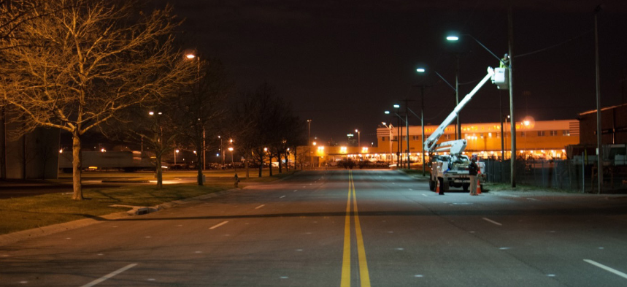
- event
22.09.2014
Faculty of Engineering of the University of Porto
Electrical and Computers Engineering Master
Examples of projects developed in collaboration with an industrial partner in 2013/2014 scholar year:
1. “Energy efficiency measures in public lighting networks” – developed in collaboration with a village municipality and a factory of lighting equipment
The main objective of this project was the study of an efficient public lighting network to a village in Azores

Slide 16
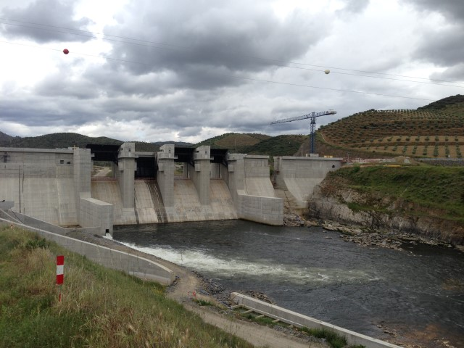
- event
22.09.2014
Faculty of Engineering of the University of Porto
Electrical and Computers Engineering Master
2. “Test and commissioning of a synchronous generator in Baixo Sabor”
The objective of this project, realized with the collaboration of EDP (Portuguese Electricity Company), owner of the hydroelectric dam and the generators manufactures (Andritz Hydro GmbH, Weiz, Austria) was to test the generators characteristics when they were being mounted

Slide 17
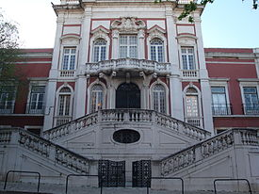
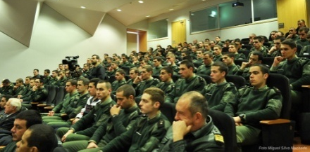
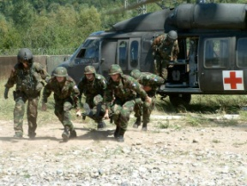

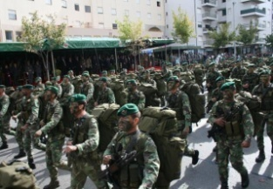
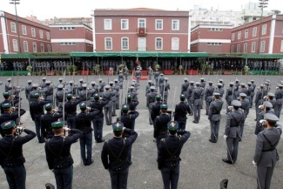
- event
22.09.2014
Military Academy
Military Electrical Engineering Master
The mission of the Military Academy (AM) states that it is a higher education military establishment that pursues:
Teaching
Research and community support activities
Educating officers for the permanent staff and services of the Army and National Guard
The Military Academy offers a five years integrated master degree, within the Bologna Framework, including the Military Electrical Engineering Master with a Telecommunications Specialization Programme

Slide 18
- event
22.09.2014
Military Academy
Military Electrical Engineering Master
The first four years are completed in the Military Academy, being the first year dedicated to the acquisition of military skills, whereas in the last two years, the students (cadetes), complete their courses in Instituto Superior Técnico (IST), in the frame of a protocol between the two institutions
The Master thesis must focus on subjects with military application and is usually supervised by a professor from the Military Academy and a professor from IST
About three/four weeks after the thesis submission there is a public discussion of the dissertation (oral exam) in front of a jury with three professors (two professors from IST and AM and a third one from a different University or Department or a specialist from the industry)

Slide 19
- event
22.09.2014
Military Academy
Military Electrical Engineering Master
Public discussion of the dissertation:
The oral exam has 60 minutes of duration
The student has 20 minutes to present his/her work (usually a PowerPoint presentation with a demonstration of the piece of equipment or prototype developed)
Afterwards, the external examiner has 20 minutes to inquire the student and finally 10 minutes for each of the remaining members of the jury
At the end of the oral exam, the student gets a final assessment in a scale of 0‑20 values

Slide 20
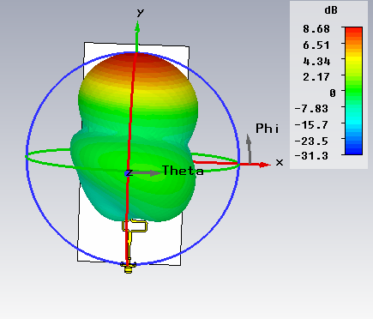
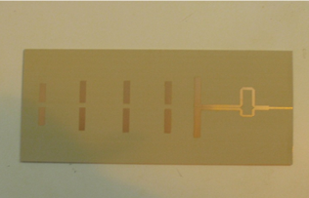
- event
22.09.2014
Military Academy
Military Electrical Engineering Master
Two examples of thesis developed in 2013 are presented:
1. A new planar integrated antenna with a configurable radiation pattern beam, was developed, using genetic algorithms, to establish communication between the unit and an autonomous surveillance robot
Planar antenna
3D radiation diagram of the antenna

Slide 21
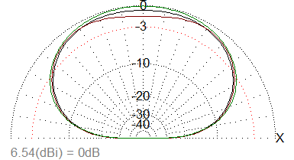
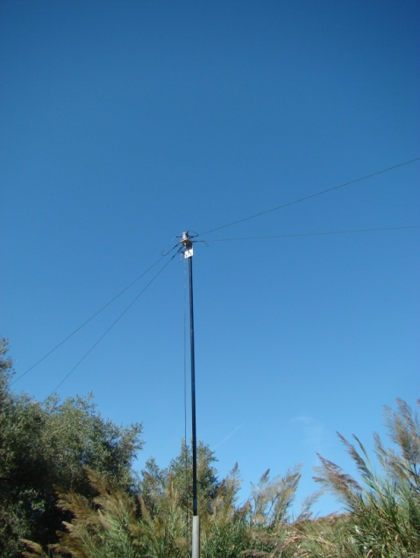
- event
22.09.2014
Military Academy
Military Electrical Engineering Master
2. A crossed dipole antenna was also designed, constructed with a collaboration from EID, a high tech company involved in research for military applications, and tested afterwards
This antenna provides Near Vertical Incidence Skywave (NVIS) communication, in the High Frequency (HF) band, allowing communications in scenarios with rugged terrain and steep mountains as is the case in Kosovo and Afghanistan, with low cost and simple set up procedures
Vertical radiation diagram of the NVIS antenna
Configuration of the NVIS antenna

Slide 22
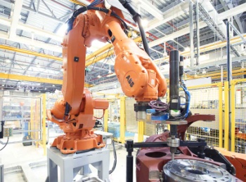
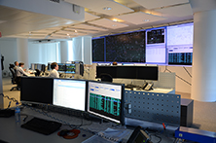

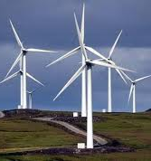
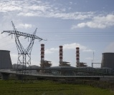

- event
22.09.2014
Coimbra Institute of Engineering (IPC/ISEC)
Master in Automation and Communications in Energy Systems
The Automation, Communications and Energy Systems areas are fundamental in energy and production systems, transportation, services and buildings
Integrates scientifically and in an industry oriented profile, the Automation, Energy Systems and Communications areas
Basis areas for the First Cycle degree in Electrical Engineering at IPC/ISEC
Reference areas in the European High Education Area
Key areas for the national and European growth

Slide 23
- event
22.09.2014
Coimbra Institute of Engineering (IPC/ISEC)
Master in Automation and Communications in Energy Systems
The Master in Automation and Communications in Energy Systems (MACES) is composed of a Specialization Course, which has a set of course units representing 55% (66 ECTS) of the total number of credits (120 ECTS), and an Industry Internship, or an original Project, that represents 45% (54 ECTS) of the total credits
MACES
Common Trunk
Energy and Automation Systems
Industrial
Systems

Slide 24
Profiles and Competences of Specialization Areas
- event
22.09.2014
Coimbra Institute of Engineering (IPC/ISEC)
Master in Automation and Communications in Energy Systems
Energy and Automation Systems | Industrial Systems
Targets competences in the production, distribution and management of energy, allowing the analysis and intervention in electrical and renewable energy systems Specialized courses on: Energy systems supervision and control Renewable energies Environmental management Electrical vehicles Energy markets | Targets competences for integrated automation and communication solutions in the industry and organizations Specialized courses on: Robotic systems Industrial networks Integration of industrial systems Mobility and wireless communications Industrial computer vision and multimedia

Slide 25
Profiles and Competences of Specialization Areas
- event
22.09.2014
Coimbra Institute of Engineering (IPC/ISEC)
Master in Automation and Communications in Energy Systems
The evaluation of the project/internship includes:
An informal distributed component resulting from the meetings between all involved persons
A progress report when planned
A public oral presentation and discussion of the project work or the internship report in the presence of a jury with three professors (two professors from IPC/ISEC and a third one from a different Polytechnic or University or a Specialist from the industry)
The evaluation is defined by the jury considering at least the following aspects:
quality of the technical and scientific contents
quality of the presented document
quality of the presentation and ability to discuss arguments and the contribution of the work to the company, school and society

Slide 26
Profiles and Competences of Specialization Areas
- event
22.09.2014
Coimbra Institute of Engineering (IPC/ISEC)
Master in Automation and Communications in Energy Systems
Public discussion of the project/internship:
The oral exam has 90 minutes of duration
The student has 20 minutes to present his/her work (usually a PowerPoint or Prezi presentation)
Afterwards, the external examiner has 40 minutes to inquire the student and finally there are 30 minutes for the remaining members of the jury
At the end of the oral exam, the student gets a final assessment in a scale of 0‑20 values

Slide 27
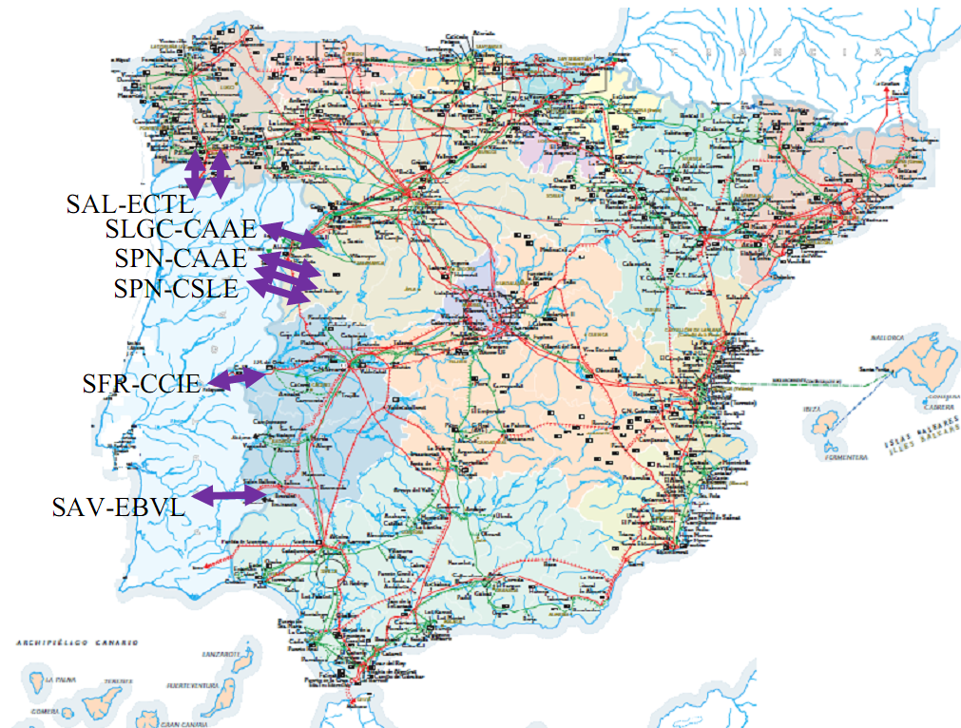
- event
22.09.2014
Coimbra Institute of Engineering (IPC/ISEC)
Master in Automation and Communications in Energy Systems
Two examples of projects developed in cooperation with the industry are first presented:
1. “Identification of the Horizontal Network Interconnecting the Portuguese and Spanish Electrical Power Systems” was developed in collaboration with the REN-Redes Energéticas Nacionais (Portuguese Transmission System Operator) The relevant network of the Spanish system was established, taking into account the actual interconnections and the new cross border tie line in Douro International with a voltage level of 400 kV
Cross-border tie-lines between Portugal and Spain
Cross-border tie-lines between Portugal and Spain

Slide 28
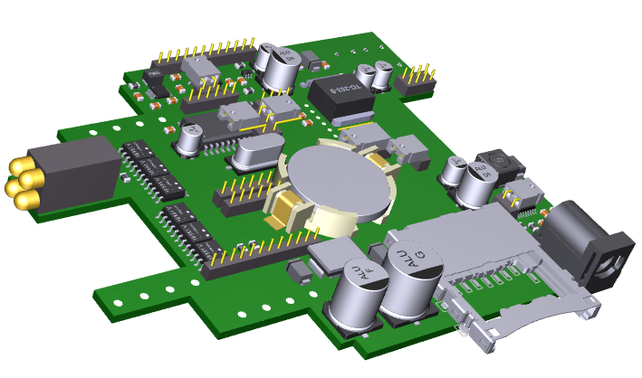
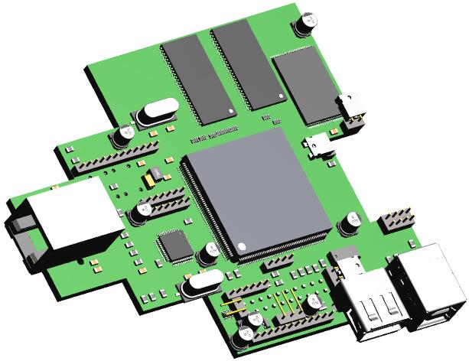
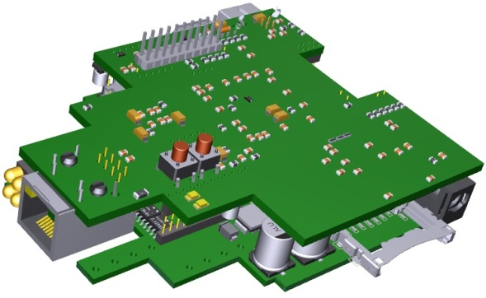
- event
22.09.2014
Coimbra Institute of Engineering (IPC/ISEC)
Master in Automation and Communications in Energy Systems
2. “Project and Implementation of a Linux-based Real-Time Embedded System” aimed at studying and implementing emerging technologies associated with the development of embedded systems
Developed Embedded System
Main Board
CPU Board

Slide 29

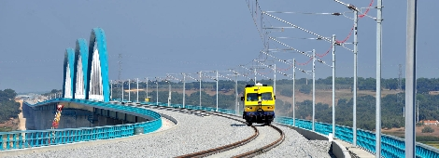
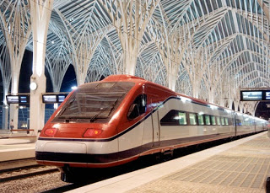
- event
22.09.2014
Coimbra Institute of Engineering (IPC/ISEC)
Master in Automation and Communications in Energy Systems
Two examples of projects which were fully developed during industry internships:
1. “GSM-R Implementation in the National Rail Network - Pilot Project Internship at Refer Telecom”
The internship took place in the company Refer Telecom, Serviços de Telecomunicações, S.A. which is a group company from REFER EPE (public company responsible for providing the public service of managing the national railway network infrastructure in Portugal)

Slide 30
- event
22.09.2014
Coimbra Institute of Engineering (IPC/ISEC)
Master in Automation and Communications in Energy Systems
2. “Analysis and a Proposal for the Revision of the SDH Technology Maintenance Procedures in the Automation and Telecontrol of the Electrical Grid
Internship at EDP Distribution”
This Internship Report presents the study carried out with the objective of knowing the architecture and technologies that support the EDP‑D network
The National Electric System, EDP and the Telecommunication Systems used by EDP‑D are presented, together with the technologies that support the Automation and Telecontrol of the Electric Grid, with special emphasis on the SDH technology
The study includes the role of the Telecommunications Systems on the supervision and operation of the electrical network

Slide 31
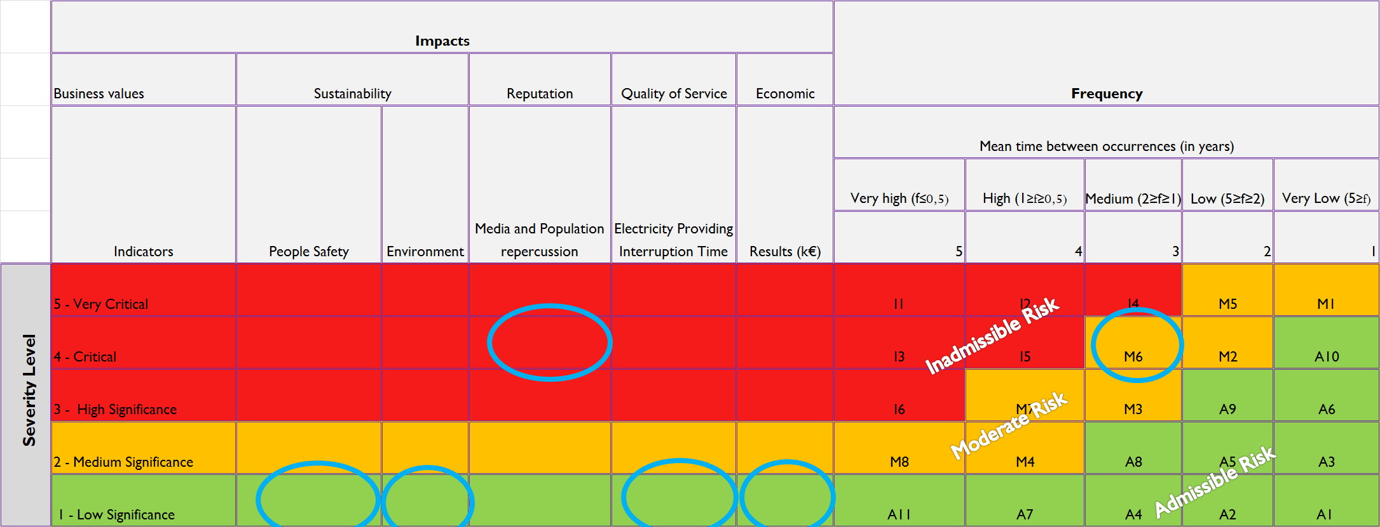
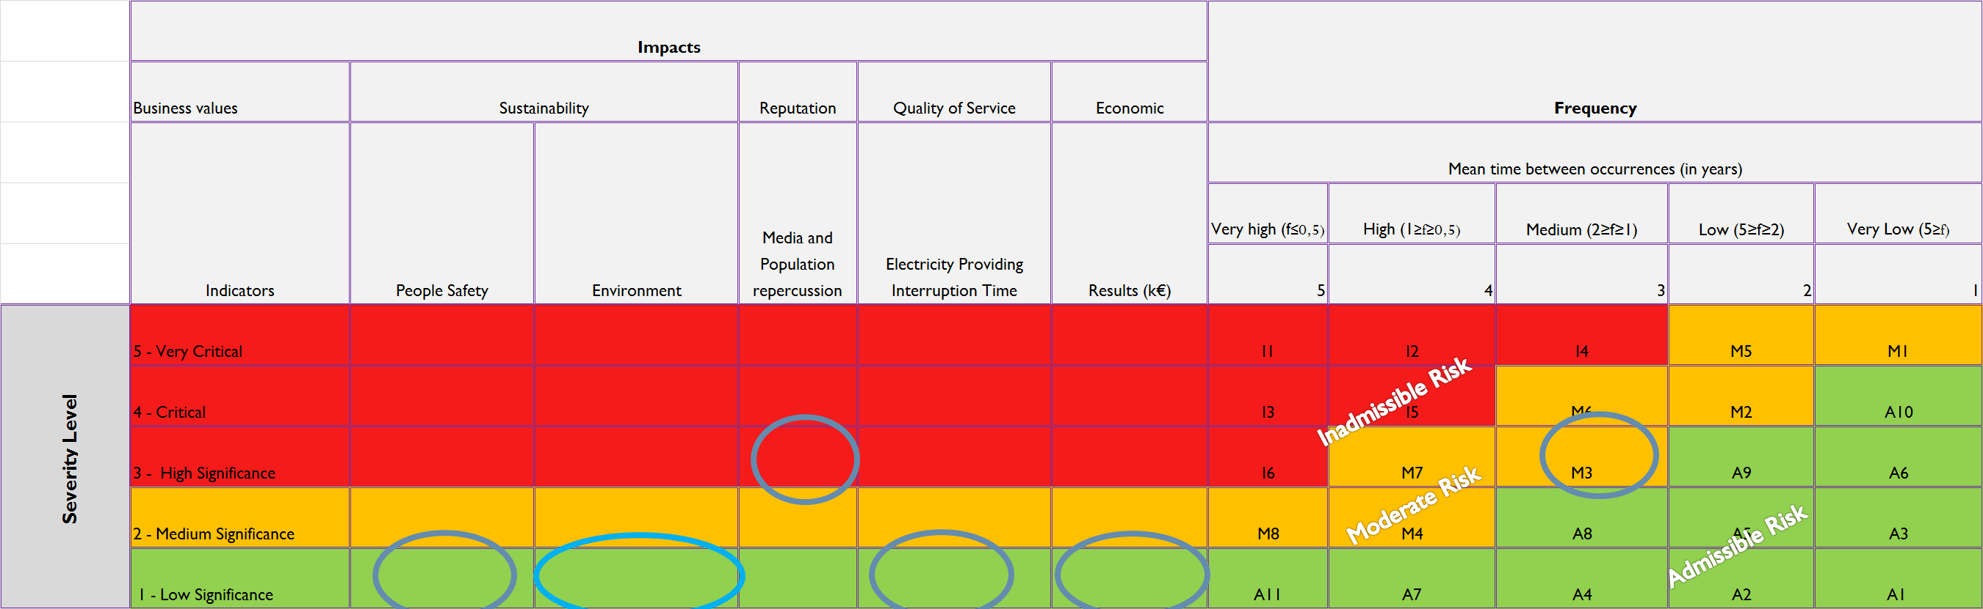
- event
22.09.2014
Coimbra Institute of Engineering (IPC/ISEC)
Master in Automation and Communications in Energy Systems
The resultant risk matrices for each scenario are shown in the following figures:
Resultant Risk Matrix for SDH equipment located next to SCADA Front‑Ends
Resultant Risk Matrix for SDH equipment located in intermediate points of the network

Slide 32
- event
22.09.2014
Conclusions
Nowadays, projects in an industrial environment or internships are a reality and students are very motivated to engage on them
Projects, whenever possible, should be developed under a cooperation agreement with an industry partner or with an institution
On the other hand, the internships allow the students to be integrated in an industrial or company environment, where he/she will have the opportunity to apply the knowledge and techniques learned in the academic course, as well as to work in teams and to envisage a professional career
The ability to design, fabricate and test, providing hands-on experience is very valued by the students and is the essential part of the engineering paradigm
The number of students asking for projects in an industrial environment or internships is growing every year

Slide 33
- event
22.09.2014
Conclusions
Most of the students are of the opinion that the internship is a good opportunity to get relevant experience and if possible go abroad, but it is difficult to get enough scholarships for all interested students
After projects in an industrial environment or an internship, many students get a job in a company
Some interns find permanent, paid employment with the organisations where they served as interns ― this can be also a significant benefit to the employer as experienced interns often need little or no training when they begin their regular employment
In general, the internships/projects have proved very good quality, with an excellent acceptance by industry and having achieved very good ratings, many with juries integrating professors and outside experts

Slide 34


Slide 35
- event
22.09.2014
Enhancing Engineering Education through Academia Industry Cooperation at the Master’s Degree Level
Fernando Maciel Barbosa – FEUP Porto – fmb@fe.up.pt

