Slide 1





Employability Skills and Professional Competences for Graduates in IT; experience of the UK
Edwin Gray– GCU Glasgow – e.gray@gcu.ac.uk
IREN CONGRESS CENTRE, GENOVA,ITALY
25.09.14
- 14 Forum
25.09.14
Edwin Gray e-mail: e.gray@gcu.ac.uk
Department of Computer, Communications and Interactive Systems

Slide 2


Slide 3
-
14 Forum
25.09.14
OUTLINE
1.Introduction
2.SFIA Framework and Employability
3.SFIA Framework and Knowledge Management
4.Knowledge Management Skills Map
5.Conclusions
Edwin Gray e-mail: e.gray@gcu.ac.uk
Department of Computer, Communications and Interactive Systems

Slide 4

-
14 Forum
25.09.14
Black-Eyed Peas song ”I gotta Feeling” gets 8.9 of 10 from Hit Song Science software
Edwin Gray e-mail: e.gray@gcu.ac.uk
Department of Computer, Communications and Interactive Systems

Slide 5
-
14 Forum
25.09.14
Introduction
Employability skills are the emphasis of this presentation in the context of the course curriculum. The role of employability in higher education covers traditional academic skills, personal development skills, and enterprise or business skills.
Edwin Gray e-mail: e.gray@gcu.ac.uk
Department of Computer, Communications and Interactive Systems

Slide 6
-
14 Forum
25.09.14
Introduction
However, the concept of employability skills for the student in the classroom is often somewhat abstract and relates to a future beyond higher education. It has been found that students have a low level of awareness of skills they are developing at university.
Edwin Gray e-mail: e.gray@gcu.ac.uk
Department of Computer, Communications and Interactive Systems

Slide 7
-
14 Forum
25.09.14
Introduction
In order to make students more aware of what employers expect, employability skills are identified and integrated in a new course. The Skills Framework for the Information Age (SFIA) is being used as one of the main drivers for this in the course development.
Edwin Gray e-mail: e.gray@gcu.ac.uk
Department of Computer, Communications and Interactive Systems

Slide 8
-
14 Forum
25.09.14
Introduction
The UK, with a number of well established national credit and qualifications frameworks for higher education, such as the Framework for Higher Education Qualifications in England, Wales and Northern Ireland, and the SCQF in Scotland, has qualification descriptors designed to meet the “easily readable and comparable” criterion in the Bologna Declaration.
Edwin Gray e-mail: e.gray@gcu.ac.uk
Department of Computer, Communications and Interactive Systems

Slide 9
-
14 Forum
25.09.14
OUTLINE
1.Introduction
2.SFIA Framework and Employability
3.SFIA Framework and Knowledge Management
4.Knowledge Management Skills Map
5.Conclusions
Edwin Gray e-mail: e.gray@gcu.ac.uk
Department of Computer, Communications and Interactive Systems

Slide 10
-
14 Forum
25.09.14
SFIA Framework and Employability
In order to make students more aware of what employers expect in terms of employability skills in the IT sector, the Skills Framework for the Information Age (SFIA) is being used as one of the main drivers.
Edwin Gray e-mail: e.gray@gcu.ac.uk
Department of Computer, Communications and Interactive Systems

Slide 11
-
14 Forum
25.09.14
SFIA Framework and Employability
SFIA gives employers a framework which they can use to measure the skills they have against the skills they need, and tells education and training providers what the job market wants. It is supported by four key organisations as follows:
Edwin Gray e-mail: e.gray@gcu.ac.uk
Department of Computer, Communications and Interactive Systems

Slide 12
-
14 Forum
25.09.14
SFIA Framework and Employability
It is supported by four key organisations as follows:
BCS – British Computer Society
• e-skills UK – Sector Skills Council for IT and Telecoms
• IET –Institution of Engineering and Technology
• IMIS – Institute for the Management of Information Systems
Edwin Gray e-mail: e.gray@gcu.ac.uk
Department of Computer, Communications and Interactive Systems

Slide 13
-
14 Forum
25.09.14
SFIA Framework and Employability
BCS in conjunction with SFIA offer a skills matrix, called SFIAplus, which contains the framework of IT skills plus detailed training and development resources. It provides the most established and widely adopted IT skills, training and development model reflecting current industry needs.
Edwin Gray e-mail: e.gray@gcu.ac.uk
Department of Computer, Communications and Interactive Systems

Slide 14
-
14 Forum
25.09.14
SFIA Framework and Employability
The BCS and IET accredit degree programmes for professional recognition using a number of criteria such as SFIAplus as well as academic curriculum content
Edwin Gray e-mail: e.gray@gcu.ac.uk
Department of Computer, Communications and Interactive Systems

Slide 15
-
14 Forum
25.09.14
SFIA Framework and Employability
SFIAplus can be viewed as a three-dimensional model which consists of categories of work (comprising 78 specific skills), levels of responsibility and some task components – see Figure 1
Edwin Gray e-mail: e.gray@gcu.ac.uk
Department of Computer, Communications and Interactive Systems

Slide 16
-
14 Forum
25.09.14
Figure 1: SFIA plus Model
Edwin Gray e-mail: e.gray@gcu.ac.uk
Department of Computer, Communications and Interactive Systems

Slide 17
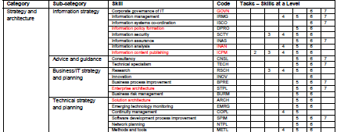
-
14 Forum
25.09.14
Figure 1: SFIA plus Matrix (part of)
Edwin Gray e-mail: e.gray@gcu.ac.uk
Department of Computer, Communications and Interactive Systems

Slide 18
-
14 Forum
25.09.14
SFIA Framework and Employability
The dimensions of the model are formulated according to:
1. SIX main Categories of Work
  Strategy and Planning
  Development
  Business Change
  Service Provision
  Procurement and Management Support
  Ancillary Skills
Edwin Gray e-mail: e.gray@gcu.ac.uk
Department of Computer, Communications and Interactive Systems

Slide 19
-
14 Forum
25.09.14
SFIA Framework and Employability
2. SEVEN Levels of Responsibility
  Follow
  Assist
  Apply
  Enable
  Ensure, Advise
  Initiate, Influence
  Set Strategy, Inspire, Mobilise
Edwin Gray e-mail: e.gray@gcu.ac.uk
Department of Computer, Communications and Interactive Systems

Slide 20
-
14 Forum
25.09.14
SFIA Framework and Employability
3. SIX Task Components
  Background
  Work Activities
  Knowledge and Skills
  Training Activities
  Professional Development Activities
  Qualifications
Edwin Gray e-mail: e.gray@gcu.ac.uk
Department of Computer, Communications and Interactive Systems

Slide 21
-
14 Forum
25.09.14
SFIA Framework and Employability
SFIAplus can be used to:
identify and benchmark skills to the industry standard;
map current skills within an IT job role;
identify career paths;
plan training and development activities, achieving BCS Accreditation
Edwin Gray e-mail: e.gray@gcu.ac.uk
Department of Computer, Communications and Interactive Systems

Slide 22
-
14 Forum
25.09.14
OUTLINE
1.Introduction
2.SFIA Framework and Employability
3.SFIA Framework and Knowledge Management
4.Knowledge Management Skills Map
5.Conclusions
Edwin Gray e-mail: e.gray@gcu.ac.uk
Department of Computer, Communications and Interactive Systems

Slide 23
-
14 Forum
25.09.14
SFIA Framework and Knowledge Management
The Knowledge Management (KM) course at Southampton Solent University (SSU) aims to develop:
problem solving,
communications,
teamwork
and the specific skills needed by the emerging information management technologies
Edwin Gray e-mail: e.gray@gcu.ac.uk
Department of Computer, Communications and Interactive Systems

Slide 24
-
14 Forum
25.09.14
SFIA Framework and Knowledge Management
Moreover, the programme is designed to meet employers’ need for innovative expertise and students’ needs for an engaging, developmental and interesting course of study, leading ultimately to rewarding employment.
Edwin Gray e-mail: e.gray@gcu.ac.uk
Department of Computer, Communications and Interactive Systems

Slide 25
-
14 Forum
25.09.14
SFIA Framework and Knowledge Management
There is not a universal and standardised skills framework, so SFIAplus was chosen as the reference against which employability skills are mapped.
Edwin Gray e-mail: e.gray@gcu.ac.uk
Department of Computer, Communications and Interactive Systems

Slide 26
-
14 Forum
25.09.14
SFIA Framework and Knowledge Management
A novel presentation of the SFIA framework is given in Figures 2 (a) and (b) within the context of Knowledge Management – all of the 78 skills are displayed across six categories – however, the ones which are not considered relevant to KM are shown in grey
Edwin Gray e-mail: e.gray@gcu.ac.uk
Department of Computer, Communications and Interactive Systems

Slide 27
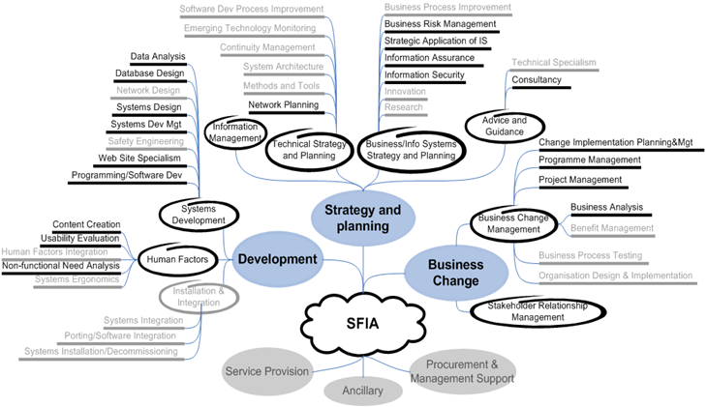
-
14 Forum
25.09.14
Figure 2 (a): SFIA framework in the context of KM – Part 1
Edwin Gray e-mail: e.gray@gcu.ac.uk
Department of Computer, Communications and Interactive Systems

Slide 28
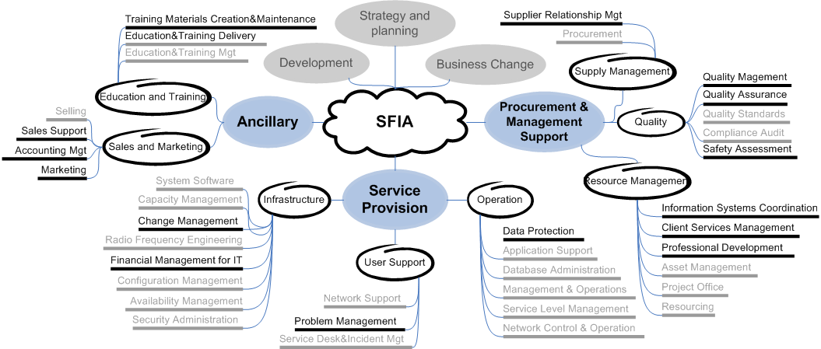
-
14 Forum
25.09.14
Figure 2 (b): SFIA framework in the context of KM – Part 2
Edwin Gray e-mail: e.gray@gcu.ac.uk
Department of Computer, Communications and Interactive Systems

Slide 29
-
14 Forum
25.09.14
OUTLINE
1.Introduction
2.SFIA Framework and Employability
3.SFIA Framework and Knowledge Management
4.Knowledge Management Skills Map
5.Conclusions
Edwin Gray e-mail: e.gray@gcu.ac.uk
Department of Computer, Communications and Interactive Systems

Slide 30
-
14 Forum
25.09.14
Knowledge Management Skills Map
Following the approach of TFPL/KnowledgeRecruit a KM skills map is shown in Figure 3 drawing from Figure 2 previously. 37 skills have been selected from the SFIA framework with the six categories of skills indicated graphically using a weighting scale for KM.
Edwin Gray e-mail: e.gray@gcu.ac.uk
Department of Computer, Communications and Interactive Systems

Slide 31
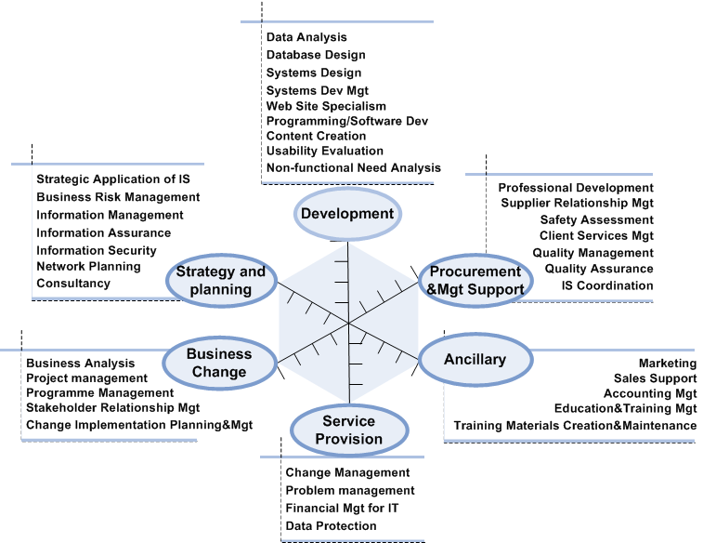
-
14 Forum
25.09.14
Fig. 3 Knowledge Management Skills Map
Edwin Gray e-mail: e.gray@gcu.ac.uk
Department of Computer, Communications and Interactive Systems

Slide 32
-
14 Forum
25.09.14
Knowledge Management Skills Map
Using KM skills maps to present the employability skills is seen as helpful both for the students and the new course delivery.
Some activities tend to the technology side and others to business.
Two sample activities are given here to explain how they can be represented and distinguished
via KM skills maps
Edwin Gray e-mail: e.gray@gcu.ac.uk
Department of Computer, Communications and Interactive Systems

Slide 33
-
14 Forum
25.09.14
Knowledge Management Skills Map
Activity 1: Create a prediction model of consumer behaviour in a given area using artificial neural networks for clustering and Bayesian belief networks for forecasting.
Activity 2: Present one set of information “perfectly”.
Edwin Gray e-mail: e.gray@gcu.ac.uk
Department of Computer, Communications and Interactive Systems

Slide 34
-
14 Forum
25.09.14
Knowledge Management Skills Map
For example, students are expected to achieve the following knowledge, understanding and skills at the completion of their study for Activity 1:
Edwin Gray e-mail: e.gray@gcu.ac.uk
Department of Computer, Communications and Interactive Systems

Slide 35
-
14 Forum
25.09.14
Knowledge Management Skills Map
Make appropriate use of data management technologies (data acquisition, processing, administration, retrieval or mining) to analyse the data from certain application areas.
Apply the basic concepts and principles of artificial neural networks and Bayesian belief networks; make appropriate use of tools in the creation of predictive models.
Edwin Gray e-mail: e.gray@gcu.ac.uk
Department of Computer, Communications and Interactive Systems

Slide 36
-
14 Forum
25.09.14
Knowledge Management Skills Map
Describe, explain and evaluate the models to assist in the analysis of consumer behaviour.
Edwin Gray e-mail: e.gray@gcu.ac.uk
Department of Computer, Communications and Interactive Systems

Slide 37
-
14 Forum
25.09.14
Knowledge Management Skills Map
The KM skills maps for Activity 1 is given in Figure 4 (a), where skills which are not considered to be achieved by the activity are again shown in grey.
Edwin Gray e-mail: e.gray@gcu.ac.uk
Department of Computer, Communications and Interactive Systems

Slide 38
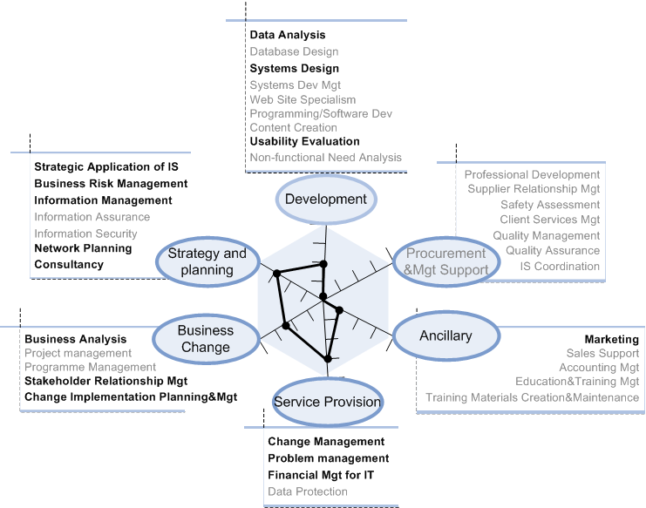
-
14 Forum
25.09.14
Fig. 4(a) K M Skills Map for Prediction Model (Activity 1)
Edwin Gray e-mail: e.gray@gcu.ac.uk
Department of Computer, Communications and Interactive Systems

Slide 39
-
14 Forum
25.09.14
Knowledge Management Skills Map
Activity 2 emphasises the development of skills relating to the presentation of the various forms of information. It aims to “present the right information in the right way to the right audience”. It also provides a holistic understanding of the role and function of information together with its representation and delivery. Various techniques and methods will be viewed as devices for “perfectly” presenting information.
Edwin Gray e-mail: e.gray@gcu.ac.uk
Department of Computer, Communications and Interactive Systems

Slide 40
-
14 Forum
25.09.14
Knowledge Management and Skills Map
The KM skills maps for Activity 2 is given in Figure 4 (b), where skills which are not considered to be achieved by the activity are again shown in grey.
Edwin Gray e-mail: e.gray@gcu.ac.uk
Department of Computer, Communications and Interactive Systems

Slide 41
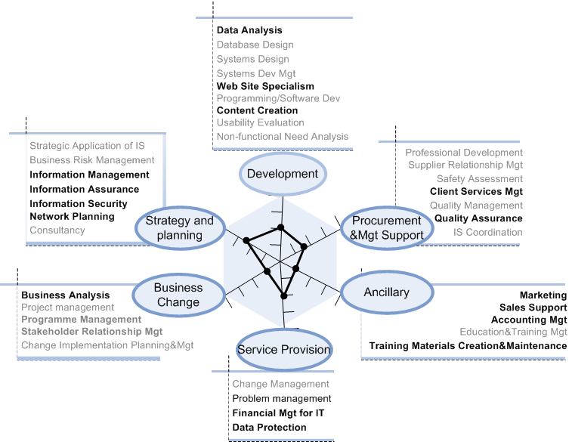
-
14 Forum
25.09.14
Fig. 4(b) K M Skills Map for Presenting Information” Perfectly” (Activity 2)
Edwin Gray e-mail: e.gray@gcu.ac.uk
Department of Computer, Communications and Interactive Systems

Slide 42
-
14 Forum
25.09.14
OUTLINE
1.Introduction
2.SFIA Framework and Employability
3.SFIA Framework and Knowledge Management
4.Knowledge Management Skills Map
5.Conclusions
Edwin Gray e-mail: e.gray@gcu.ac.uk
Department of Computer, Communications and Interactive Systems

Slide 43
-
14 Forum
25.09.14
CONCLUSIONS
The UK, with a number of well established national credit and qualifications frameworks for higher education, such as the Framework for Higher Education Qualifications in England, Wales and Northern Ireland, and the SCQF in Scotland, has qualification descriptors designed to meet the “easily readable and comparable” criterion in the Bologna Declaration.
Edwin Gray e-mail: e.gray@gcu.ac.uk
Department of Computer, Communications and Interactive Systems

Slide 44
-
14 Forum
25.09.14
CONCLUSIONS
The UK also has a set of established support systems for lifelong learning and employability. In addition to the SCQF taking account of SVQs for employability, there are PDPs, Progress Files and Employability Offices.
Edwin Gray e-mail: e.gray@gcu.ac.uk
Department of Computer, Communications and Interactive Systems

Slide 45
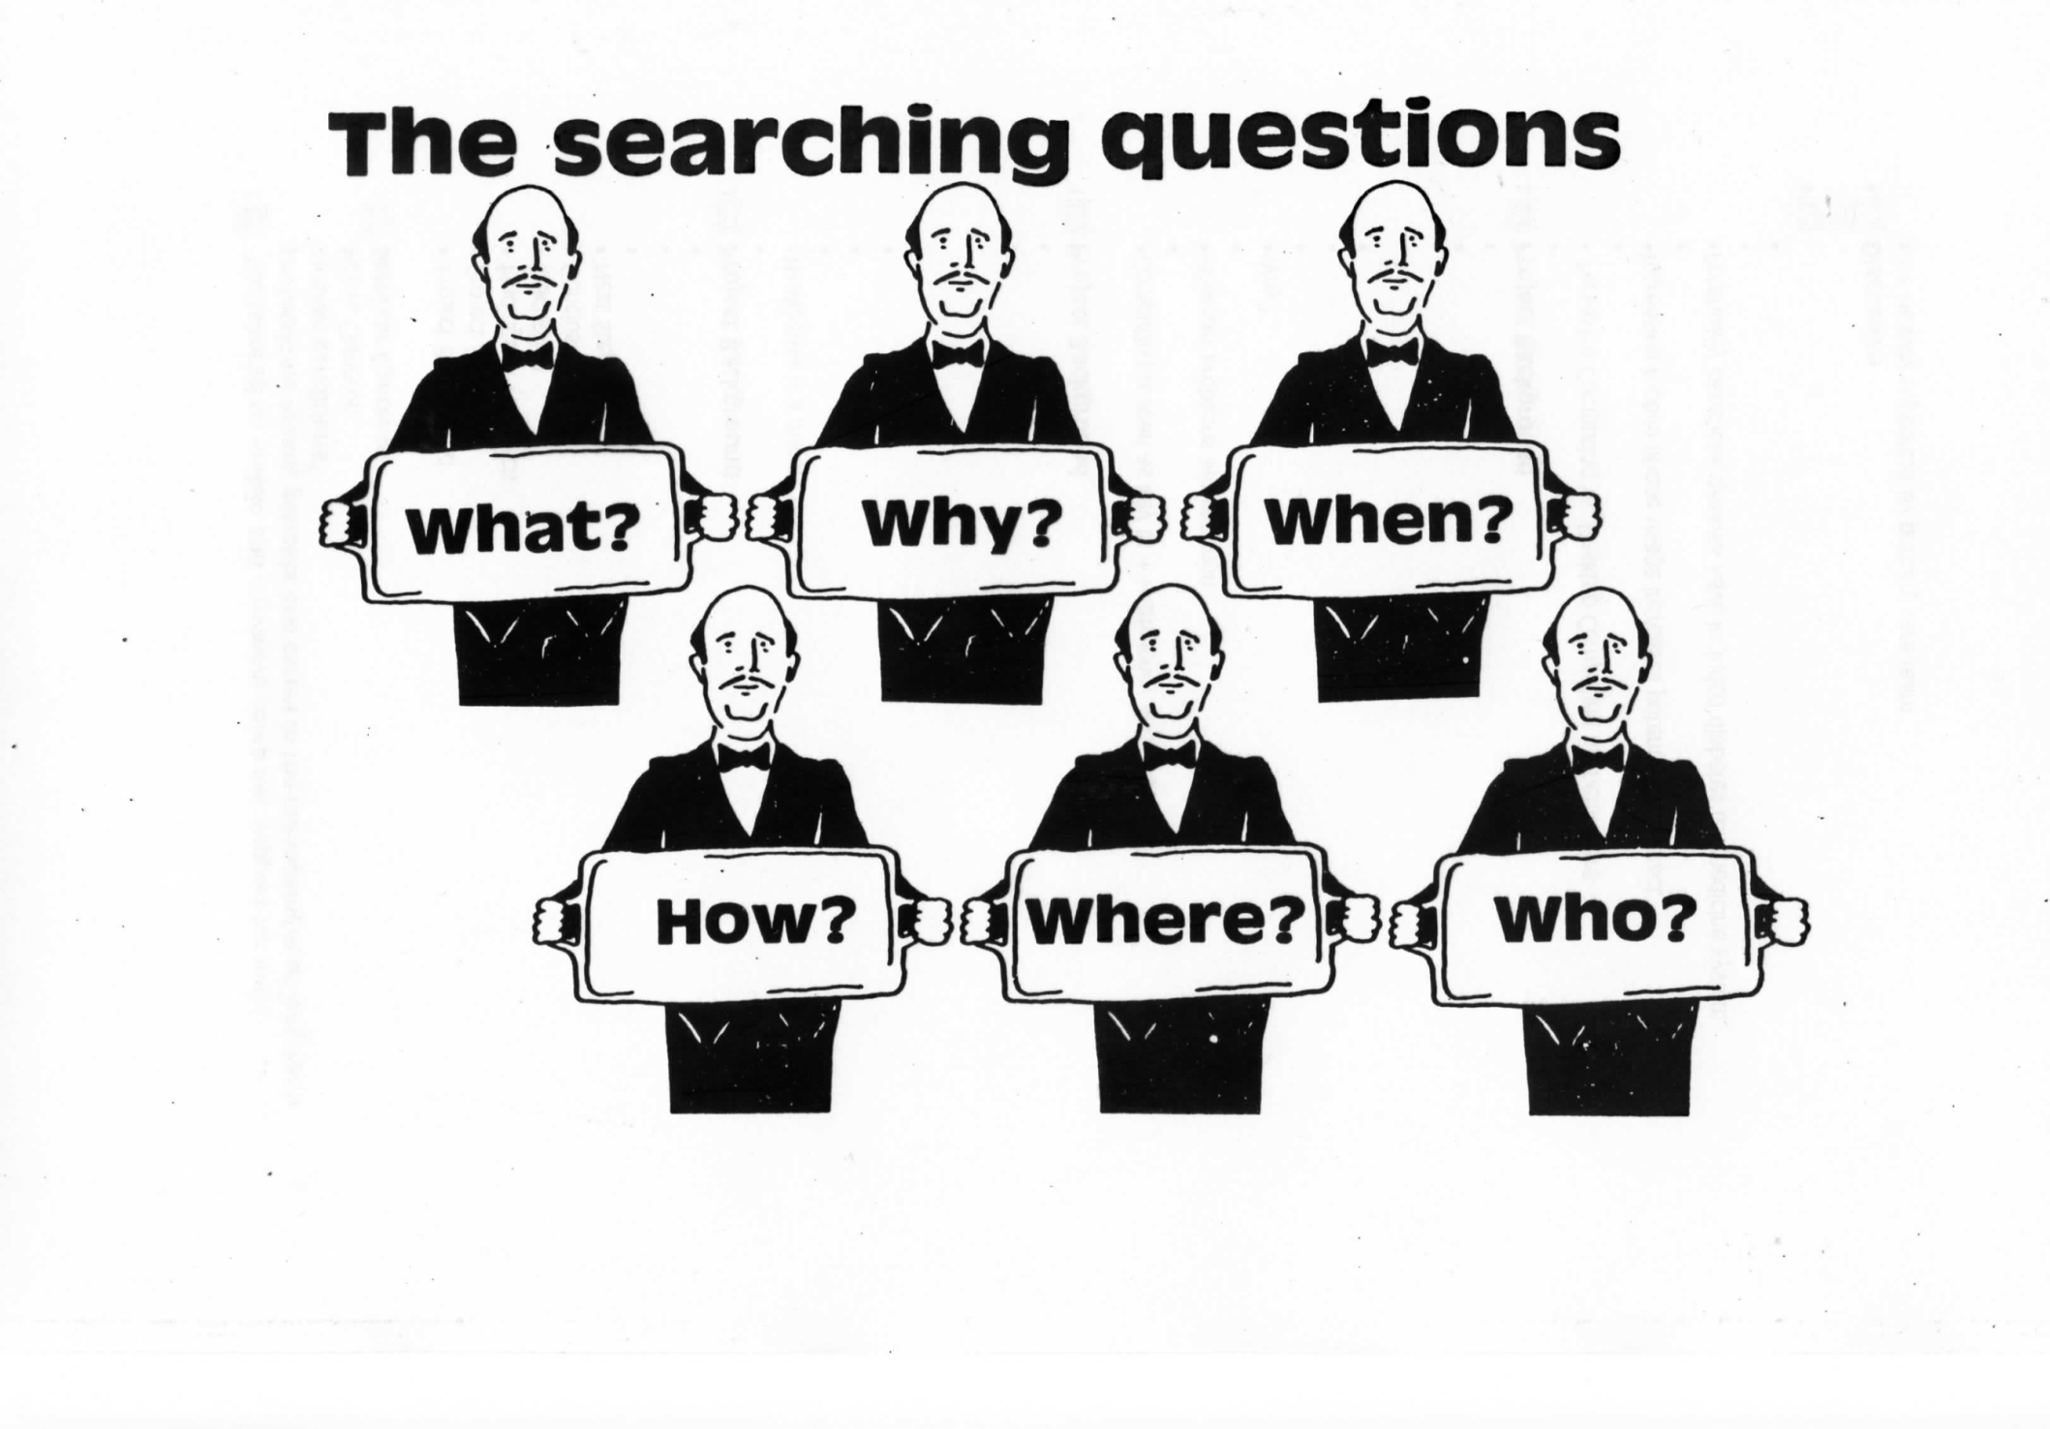
-
14 Forum
25.09.14
QUESTIONS???
Edwin Gray e-mail: e.gray@gcu.ac.uk
Department of Computer, Communications and Interactive Systems

Slide 46
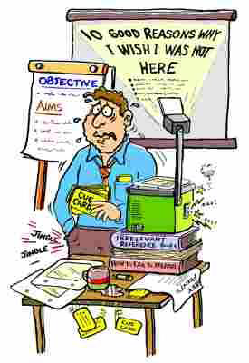
-
14 Forum
25.09.14
QUESTIONS???
Edwin Gray e-mail: e.gray@gcu.ac.uk
Department of Computer, Communications and Interactive Systems

Slide 47


Slide 48


