Slide 1

Curricular Elements of Work Integrated Higher Education
Johannes Haas,
FH JOANNEUM University of Applied Sciences,
Institute for Applied Production Sciences
Graz, Austria
johannes.haas@fh-joanneum.at

Slide 2

Content of Presentation
Introduction to and History of Work Integrated Education
Introduction to specific programmes at FH JOANNEUM
Innovation of Curriculum to meet Work Requirements
  Example: How can we best prepare students for their entrance into the world of work?
  Example: How can we support companies to include renewable energy and energy efficiency?

Slide 3
Work and Education
Challenges for HEI: Science – Nations – Industry - WWW
> 100 000 BC 10 000 BC 1000 BC 1700 AD 1900 AD
Higher Education
Coop and Work Integrated Education
Work Based Learning
Co-operative and Work Integrated Learning
Learning

Slide 4
Struggling for Positioning of Higher Education in Modern Societies
Flexible, individual learning
Labour market driven
“Pure Education” / Personal Development
Massification

Slide 5

Struggling for Labor Market Integration in Modern Societies
Go to University
to find a Job
Stay at University to find a Job
Stay at University because they do not find a Job
Personal and System Failure / Crisis
Go to University
to not have to take a Job
Stay at University because they do not want a job
Go to University to find a better Job
Age: 18-22 23-27 >30

Slide 6
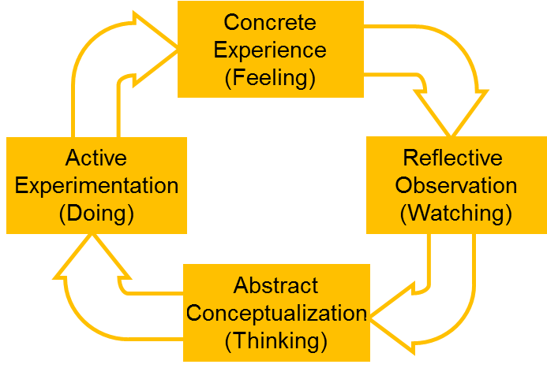
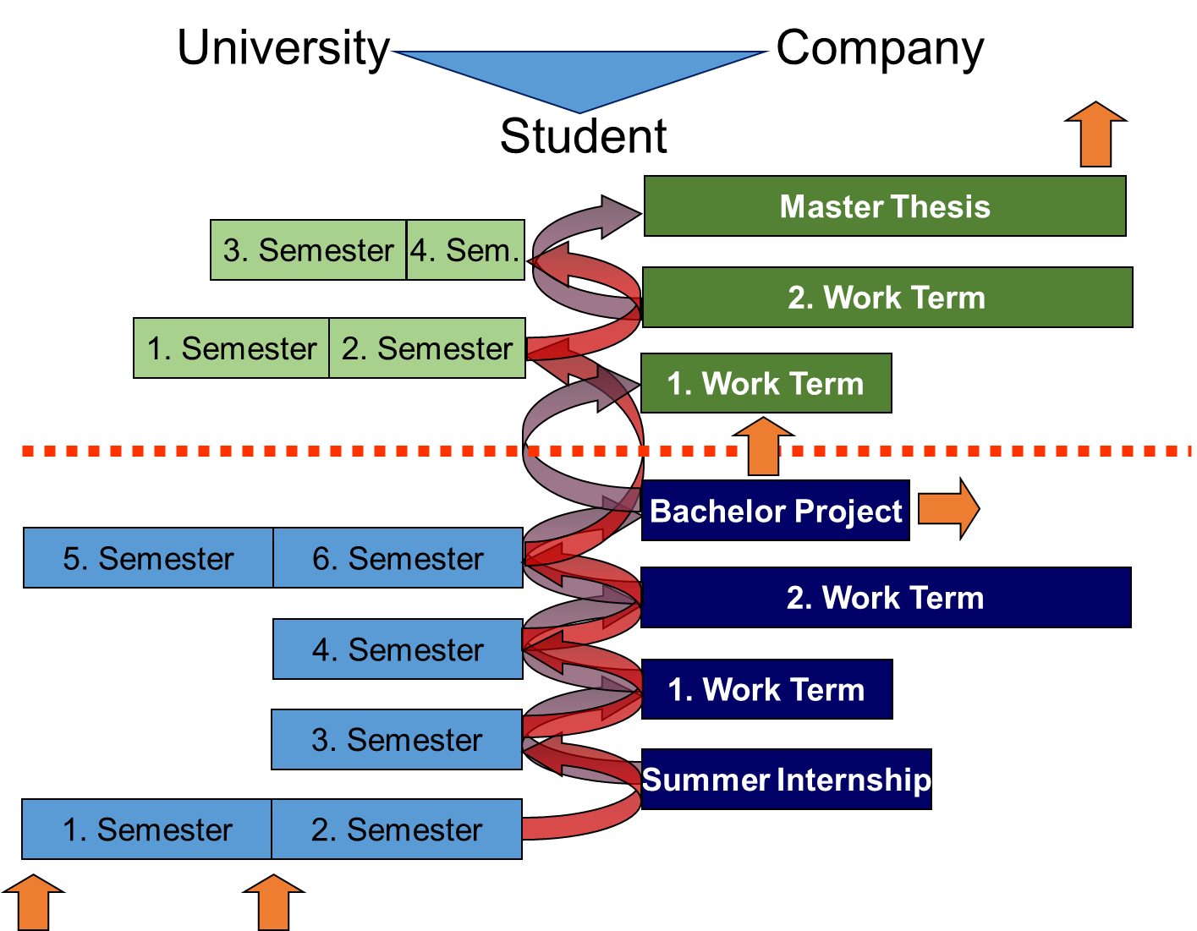
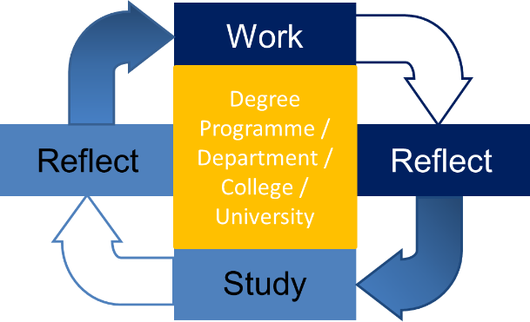
Introduction to Cooperative and Work Integrated Education
The core elements of CWIE are the close and continuous cooperation between higher education and enterprises and their representatives, and a wide range of specific elements to integrate academic curricular and professional tasks and temporary employment to form a unique and individual educational system for each participating student.
FH JOANNEUM – Production Technology and Organization
Experiential Education / Learning Cycle
David Kolb, 1974
Work Study Rotation / Alternance / Dual Education

Slide 7
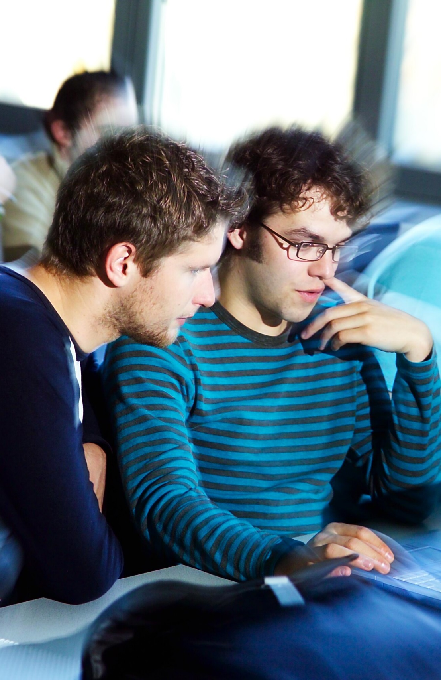
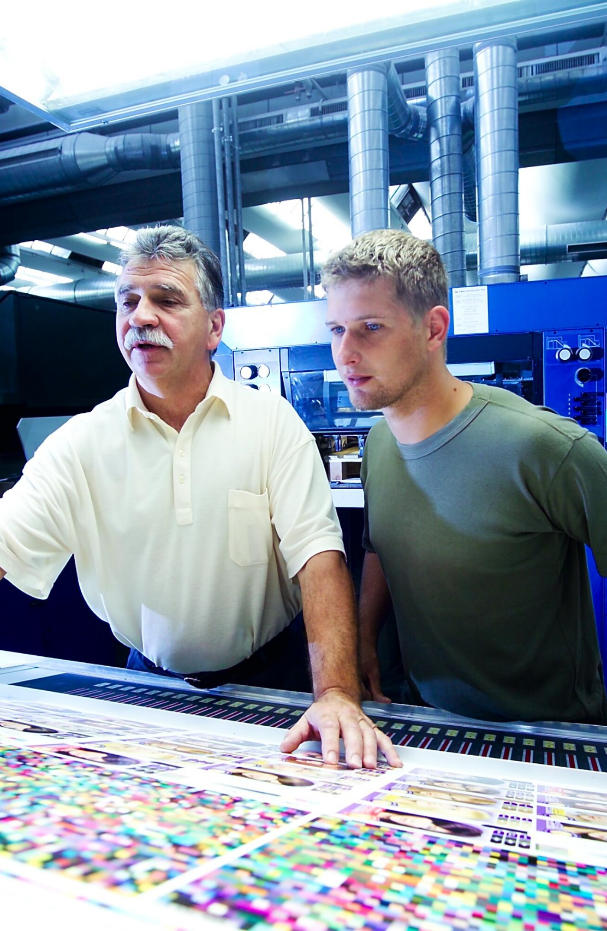
What does „Cooperative and Work Integrated Education“ mean?
University
Company
PTO

Slide 8





















































PTO Diploma Program 2002 - 2014
150 Companies
Longest Distance: 530 km (Swiss Border)
Largest Factory VOEST Alpine Linz with 10.000 employees
Smallest Factory Pink Solar Cooling with 10 employees
About 250 graduates in all possible positions
6 successful partnerships for family succession
4 successful partnerships to support start up companies
10 % female students – 15 % female graduates
Students from apprenticeship rising from 5 to 15 %
40 % of students worked abroad
25 % of students studied abroad

Slide 9
Using reflection of work place requirements to start a continuous improvement process for the curriculum
Aim & Methods
The projects aim was to understand how the student view their first COOP- period and to use findings for curriculum development.
85 (three cohorts 2011 – 2013) 2nd semester students list their highest priorities for personal learning during their first work term with the future employer (Assessment Instrument from: Cates, C. and Cederkreutz, K., Leveraging Cooperative Education to guide Curricular Innovation, University of Cincinnati, 2008).
Students and teacher analyzed the results together in the course “Reflection of Professional Practice”.

Slide 10
71 %
68 %
36 %
39 %
43 %
64 %
32 %
32 %
46 %
32 %
46 %

Slide 11
Personality development
(Ranking 1-3)
Quality of work
(Ranking 4-6)
Individual role as a knowledge broker
(Ranking 7-9)

Slide 12
Consequences for learning opportunities at the university
„Personality Development“
Regular 1st year courses: Presentation skills and problem solving competence.
Giving students responsibility throughout the entire application process.
„Quality of Work“
1st year Project Management combined with challenging tasks.
Constant feedback for students on key engineering skills during the courses so they enter the company with a realistic self image.
Clear communication and cooperation between university and companies on defining the work to be expected by students at this stage.
„Individual Role as Knowledge Broker“
Students are supported in their role as „bridges“ and knowledge brokers (f.e. through personal mentoring + additional activities by faculty).
Application of knowledge and interpretation of data in 1st year engineering.
Reflection of personal learning within work term reports and diaries.

Slide 13
Conclusion
Students in their second semester of the coop program „Production Technology and Organization“ already have a clear perception of what „work integrated learning“ will mean for them during the upcoming first work term at the coop employer.
By selecting from a list of criteria of professional competences students place highest emphasis on personality development, followed by work quality and their role as experts with a university background to generate new knowledge for their companies.
Translating these findings into curricular activities and organizational practices yields the following recommendations:
Start early with course design and assignments that reflect and train key competencies needed for a good start in the company.
Provide support and mentoring for students in their role as mediators between company and university. This should be an ongoing partnership starting with the application process and following through until a final thesis or project.
Constant personal and team reflection is a key to actual „integration“ of work and study and helps make the most not only of personal experiences but also of the variety of specific situation encountered by students of one cohort.

Slide 14
Cooperative Education -
A successful Strategy to Overcome Obstacles for
the Use of Renewable Energy Technologies in Industry
- New Degree Program
- New Labs
- R&D Projects
- New Courses
- New Course Content

Slide 15
Current Situation
Success factors (and therefore Bottlenecks) for Industry (and especially SME) Action on Energy Efficiency and Renewable Energy Technologies
Short Return-Of-Investment (RoI) Times (the easy measures were implemented long ago, now come the tricky issues)
Somebody important (preferably the head of production) really cares
Essential Facts and Figures (needed to meet above goals)
Time (f.e. to collect information for above and to meet colleagues in similar situations or other branches of industry)
In-House Skills and Knowledge (for project design and decision making)
„Hands-on Partners“ in R&D and Universities who are willing to act quickly and strictly and on behalf of the company (instead of aiming for large projects and / or publications)
All acquired knowledge stays in the company and is available for continuous improvement
Any activities towards sustainable engineering are streamlined into every day operation and well mastered organizational practice

Slide 17
Student Project – Best Practice
Brewery Goess (Heineken „Green Brewery“ Benchmark – Flow Chart „Heat“
Waste Heat
Brewing Process
Evaporation Losses
Miscellaneous
District Heat (Biomass)
Production
District Heat
Biogas
Heating
Not accounted for
Johannes Eregger, Diploma Thesis 2011

Slide 18
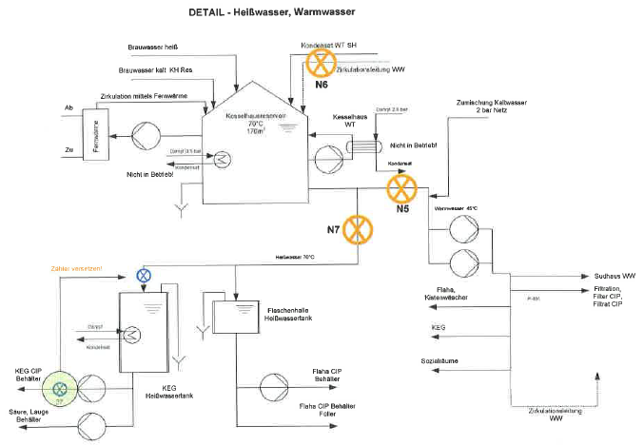

Student Project – Best Practice
Brewery Goess (Heineken „Green Brewery“ Benchmark – Hotwater Measuring Sytem)
District Heat
New Measurement Postion
New Meter
Brewing Process
Hot Water Tanks
Johannes Eregger, Diploma Thesis 2011

Slide 19
„From student learning to
company innovation“ – Success factors
Explore any possibility to include industry in a durable partnership: Advantage of multiple co-op rotations in the same company or successive students working on the same problem
Make innovation and technology transfer a main goal and outcome of placements: Many details will follow naturally (Who? What? How? Which university?)
View and challenge students in their role as „knowledge dealers“ between university and company: This would also help with several of the more complicated tasks of university (like triggering research interest in students and attracting faculty experts)
Facilitate constant „reflection-on-doing“ for all people involved: Student, faculty and company supervisor, from project planning to reporting, include questions oriented towards global, future and innovative issues
And finally: This is a special and attractive opportunity for SMEs – a single student can already make a decisive difference!

Slide 20
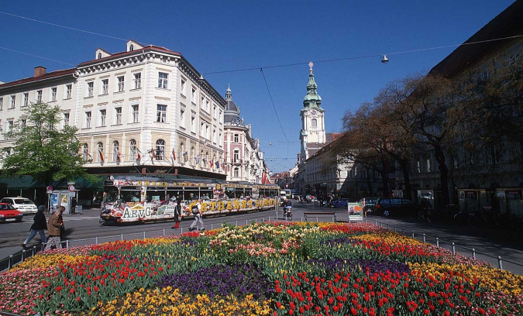
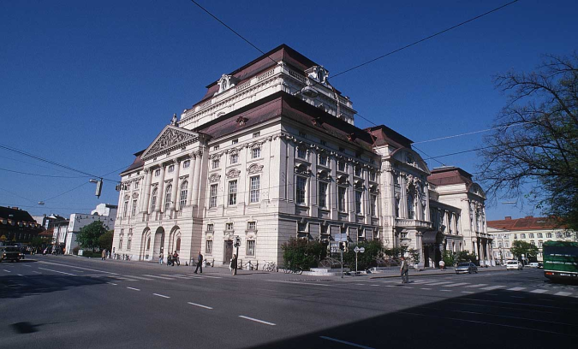
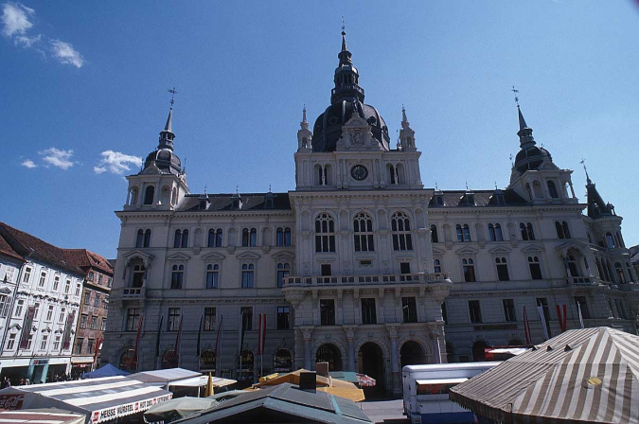
Thank you
for your attention!
I hope PRAXIS continues to be a facilitator for university – industry cooperation towards a sustainable future.
25

