Slide 1
Fostering an effective transition between education and labour
Nuno Escudeiro – ISEP, Porto – nfe@isep.ipp.pt
Paula Escudeiro – ISEP, Porto – pmo@isep.ipp.pt
Miguel Gonçalves – Spark Agency, Braga – miguel@sparkagency.pt
Laura Esteves – Spark Agency, Braga – laura@sparkagency.pt
PRAXIS Forum 2014

Slide 2
PRAXIS’14 Forum
Outline
Employability
Employability embedded in curricula
Best practices.

Slide 3
PRAXIS’14 Forum
p. 2
Employability?

Slide 4
PRAXIS’14 Forum
Employability definition
Employability as curricular process [1]
It is a mistake to assume that provision of experience is a sufficient condition for enhanced employability.
To have work experience, say, does not, of itself, ensure that the student develops (further) the various prerequisites (cognitive, social, practical, etc.) for success in employment.
The same argument applies to whole curricula. The curricular process may facilitate the development of prerequisites appropriate to employment, but does not guarantee it.
Hence it is inappropriate to assume that students are highly employable on the basis of curricular provision alone
Employability as achievement and potential
The student exhibits employability in respect of a job if he or she can demonstrate a set of achievements relevant to that job.
Employability is a (multi-faceted) characteristic of the individual.

Slide 5
PRAXIS’14 Forum
Employability definition
Employability is about three abilities [2]:
• gaining initial employment
• maintaining employment
• obtaining new employment if required
Employability is not a set of skills but a range of experiences and attributes developed through higher-level learning, thus employability is not a ‘product‘ but a process of learning [3]
A set of achievements – skills, understandings and personal attributes – that makes graduates more likely to gain employment and be successful in their chosen occupations, which benefits themselves, the workforce, the community and the economy [1]
Set of achievements allowing a person to develop a professional career in a certain area.

Slide 6
PRAXIS’14 Forum
Emotional intelligence
Social capital
Ethical assets
What I am, Behaviours, Soft skills
Intelectual capital
What I know, Factual knowledge, Procedural knowledge, Technical / Hard skills
Employability
Set of achievements allowing a person to develop a professional career in a certain area.
Academic qualifications are the first tick in the box and then we move on. Today we simply take them for granted [2]

Slide 7
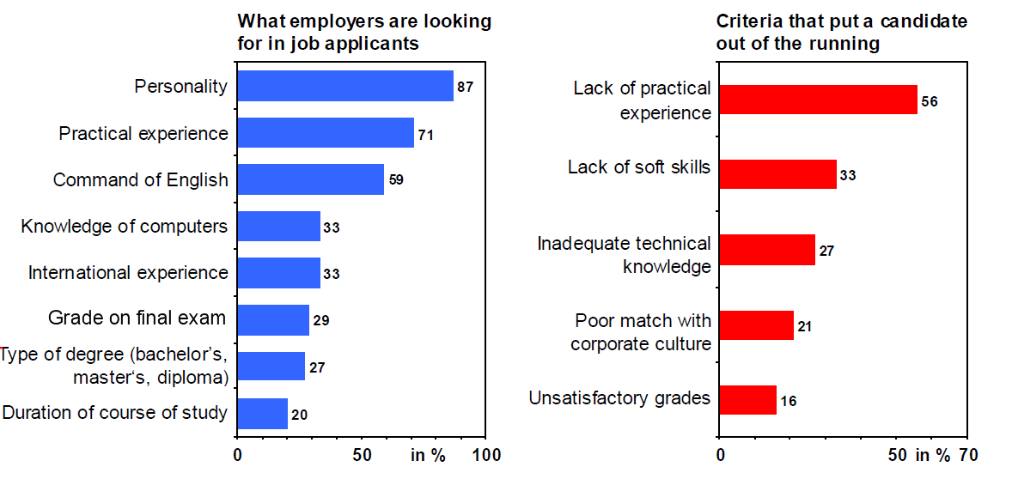
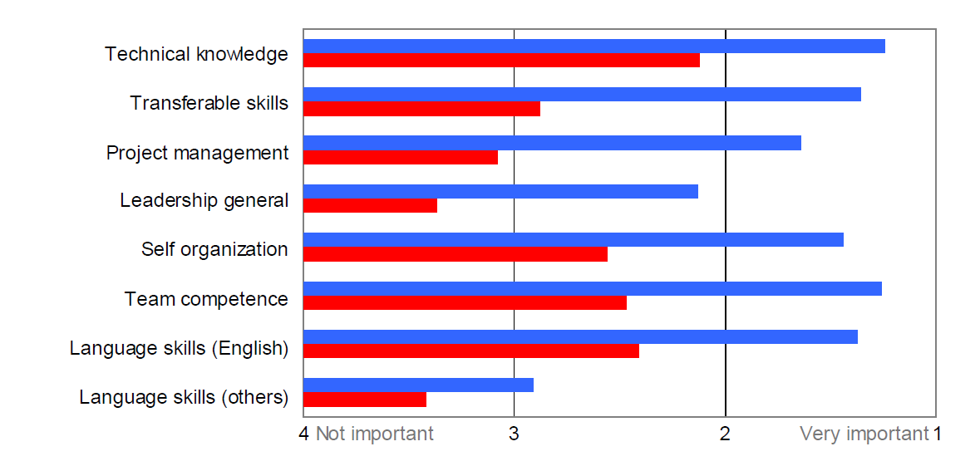
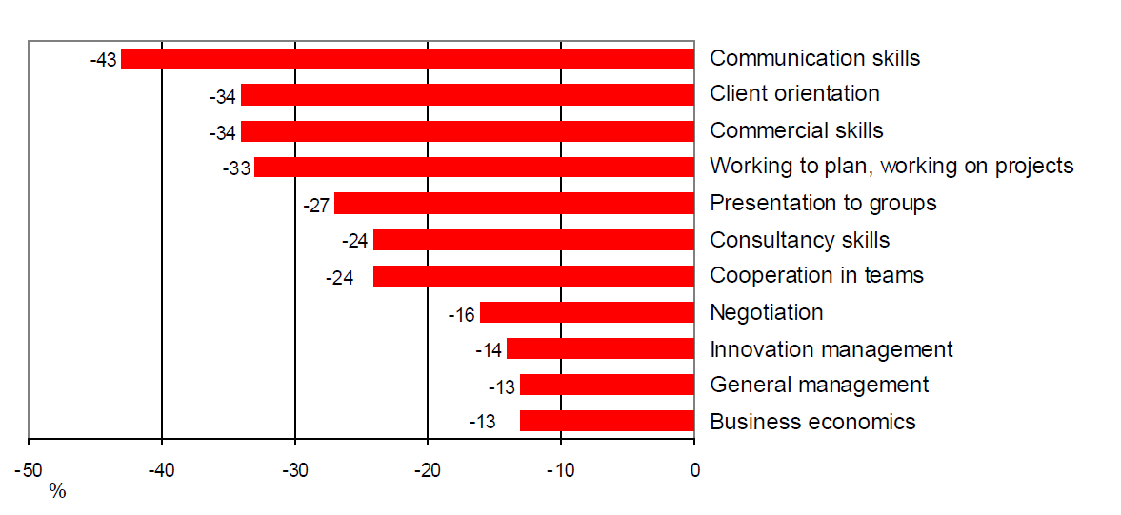
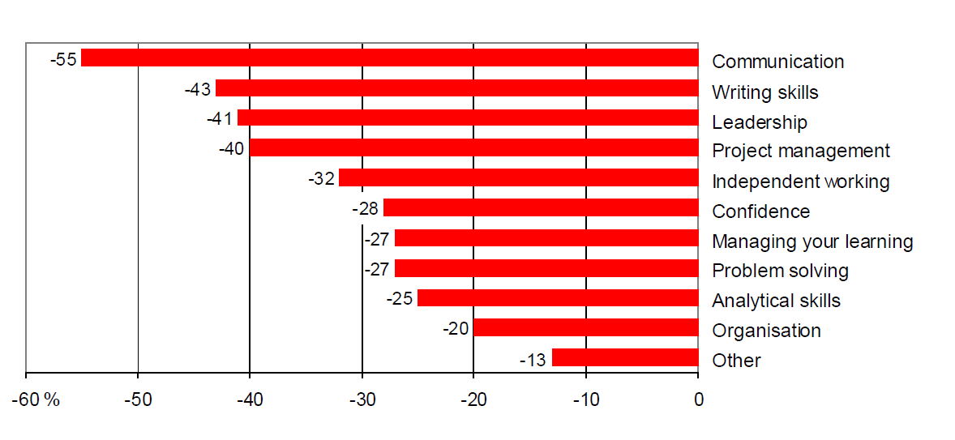
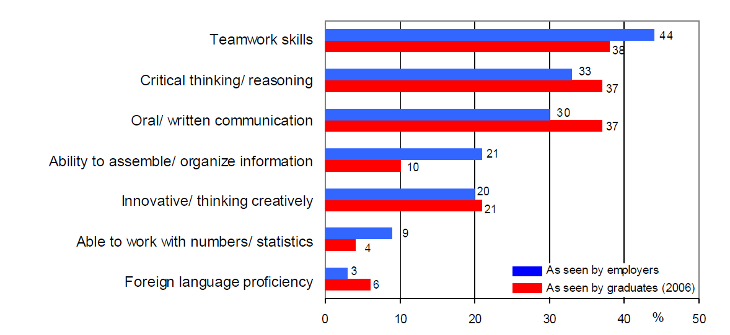
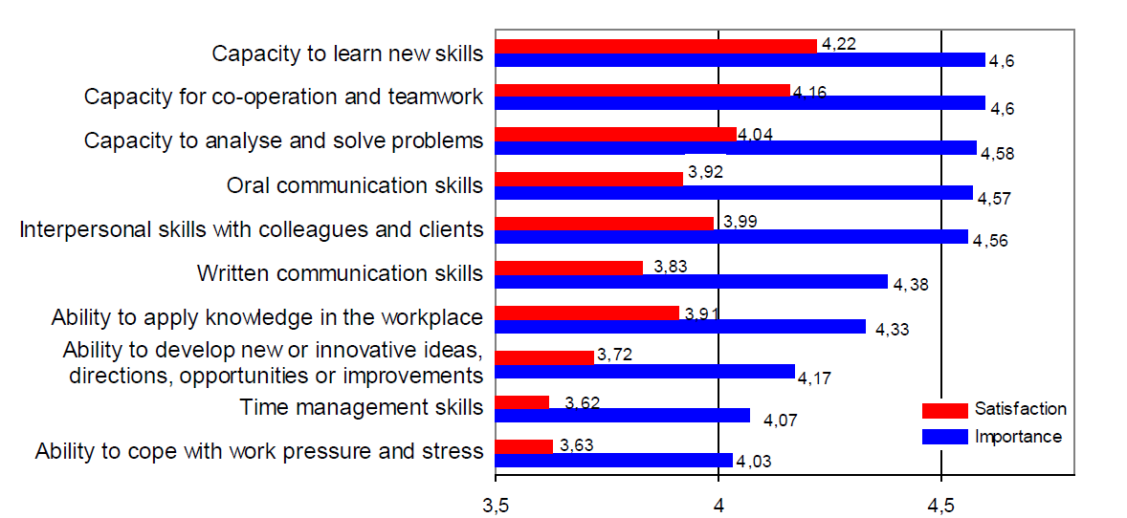
PRAXIS’14 Forum
Competences, Germany
Competences, Germany
Employers relevance and satisfaction
Source: Universum Communications and access KellyOCG for Wirtschaftswoche, 18 Abril 2011
Source: A. Bunz et al., in Innovations, World innovations in Engineering education and research, International Network for Engineering Education and Research., W. Aung, et al. (eds), iNEER, Arlington, VA, 2012
Competences, The Netherlands
Young employees defficiencies (Technology)
Competencies, Ireland
Young employees defficiencies (higher education)
Source: Careers for Science Alumni, Radboud University Nijmegen, OECD presentation, Amsterdam,11- 2005
http://www.eair.nl/forum/valencia/authors.asp?achternaam=9410&wat=achternaam
Source: P. Twomey, University of Limerick, presentation at the 2011 University Business Forum,
http://ec.europa.eu/education/higher-education/doc/business/forum2011/presentations/twomey.pdf
Competences, Australia
Employers relevance and satisfaction
Most important competences, USA
Source: P.D. Hart, (2006); http://www.aacu.org/advocacy/leap/documents/Re8097abcombined.pdf
Source: Nair et al, EJEE 34-2, p.136

Slide 8
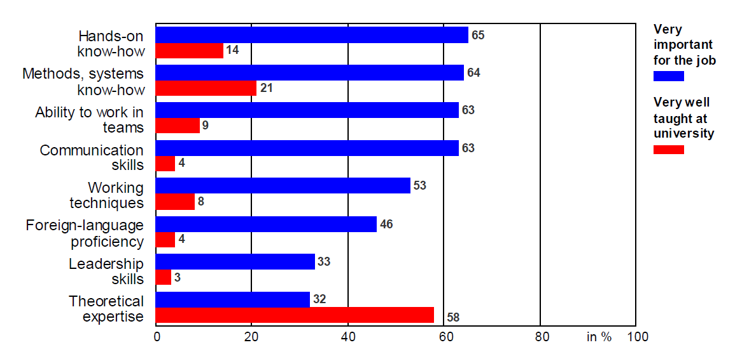
PRAXIS’14 Forum
Competences, Germany
Labour needs (mis)alignment
Source: VDE survey “Young Professionals 2009“

Slide 9
PRAXIS’14 Forum
Competences, The Netherlands
Science&Technology fresh graduates defficiencies
Source: Careers for Science Alumni, Radboud University Nijmegen, OECD presentation, Amsterdam,11- 2005
http://www.eair.nl/forum/valencia/authors.asp?achternaam=9410&wat=achternaam

Slide 10
PRAXIS’14 Forum
Competences, Germany
Source: Universum Communications and access KellyOCG for Wirtschaftswoche, 18 Abril 2011

Slide 11
PRAXIS’14 Forum
Emotional intelligence
Social capital
Ethical assets
What I am, Behaviours, Soft skills
Intelectual capital
What I know, Factual knowledge, Procedural knowledge, Technical / Hard skills
Employability!
Set of achievements allowing a person to develop a professional career in a certain area.

Slide 12
PRAXIS’14 Forum
p. 11
Employability in curricula

Slide 13
PRAXIS’14 Forum
Embedding employability in curricula [4]
• Employability through the whole curriculum
Each student is required to demonstrate eight broad abilities at progressively more complex levels in both general education and the specialist subject(s):
• Communication (reading, writing, speaking, listening, visual, quantitative, and technological literacy)
• Analysis
• Problem solving
• Valuing in decision-making
• Social interaction
• Global perspectives
• Effective citizenship
• Aesthetic responsiveness
• Employability in the core curriculum
Designate existing core modules as vehicles for the formal development of the transferable skills.

Slide 14
PRAXIS’14 Forum
Embedding employability in curricula [4]
• Work-based or work-related learning incorporated as one or more components within the curriculum
Work-based learning has for some time been promoted as a contributor to employability,
initially in terms of sandwich degrees. The ‘thick sandwich’ typically involves a one-year
placement, though there are other models that distribute the placement experience in
‘thinner’ slices. The experience is widely held to benefit the student (anecdotal evidence
attests to greater self-confidence and awareness of the challenges faced in the world of
work)
• Employability-related module(s) within the curriculum
There seems to be a growing emphasis on the development of students’ skills at the
beginning of their programmes of study, centring on freestanding ‘skills’ modules of
varying kinds
• Work-based or work-related learning in parallel with the curriculum
In academy, there is a tendency to regard the part-time employment that students
undertake in parallel with their studies as a necessary, but undesirable, commitment.

Slide 15
PRAXIS’14 Forum
What if we miss it?
Then employers do it for us!
On-the-job training requires generic competencies to adjust vocational competencies to the requirement of the job [5]
Generic competencies: combination of competencies providing a strong basis for further learning; learning abilities, problem-solving, analytical competencies, …
What if students don’t exhibit generic competences?
Then we have a problem. We are not offering value for money!

Slide 16
PRAXIS’14 Forum
What can we do?
Best practices in HE

Slide 17
PRAXIS’14 Forum
To start
Coping with today’s knowledge-based economy requires education paradigms that are grounded on critical thinking, problem solving and internationalization of education
In most study areas, education cannot be grounded/based on information transfer that does not favors questioning, exploration and autonomous learning
Involve students to have an active role.

Slide 18
PRAXIS’14 Forum
Create your own job
Support to start-ups, innovative ideas.

Slide 19
PRAXIS’14 Forum
Cooperation Education/Labour
Barriers and Drivers in European University-Business Cooperation, DG Education and Culture of the European Commission, 2012
Barriers and drivers of university-business cooperation that have been found to exist in Europe:
Business lack awareness of HEI research activities / offerings
Differing motivation / values between HEI and business
HEIs lack awareness of opportunities arising from University-Business cooperation
Difficulty in finding the appropriate collaboration partner
No appropriate initial contact person within either the HEI or business.

Slide 20
PRAXIS’14 Forum
Promote students initiative
Internationalization, international exposure, Erasmus
  Erasmus Impact Study confirms EU student exchange scheme boosts employability and job mobility - European Commission - IP/14/1025 22/09/2014
Volunteering.

Slide 21
PRAXIS’14 Forum
Curriculum development
Flexible internships
EPS – European Project Semester
Mid The Gap
MUTW – Multinational Undergraduate Team Work (blended mobility, non-formal learning, overcoming barriers to mobility).

Slide 22
PRAXIS’14 Forum
New opportunities to all
Open the European labour market to students: Praxis
Pitch Bootcamp.

Slide 23
PRAXIS’14 Forum
References
[1] Mantz Yorke, Employability in higher education: what it is – what it is not, Higher Education Academy, 2006
[2] Hillage, J., Pollard, E., Employability: developing a framework for policy analysis. London: Department for Education and Employment, 1998
[3] Harvey L., Defining and measuring employability. Quality in Higher Education, 7 (2), 2001
[4] Mantz Yorke, Peter T Knight, Embedding employability into the curriculum, The Higher Education Academy, 2006
[5] Hans Heijke, Christoph Meng, Catherine Ris, Fitting to the job: the role of generic and vocational competencies in adjustment and performance, Labour Economics, 10, pp 215—229, 2003
[6] A. Fairuza et. Al., Employers’ perception on soft skills of graduates: a study of Intel Elite soft skill training, International Conference on Teaching and Learning in Higher Education, 2011

Slide 24


