Slide 1
QUALITY IN HIGHER EDUCATION
AND BENEFITS FROM THE INTERNSHIPS
G. Liodakis, K. Loulakakis, I.O. Vardiambasis, I.A. Kaliakatsos
TEI of CRETE, GREECE
URL: http://www.teicrete.gr
E-mail: giankal@staff.teicrete.gr

Slide 2
Introduction
In this work we examine how the quality of education is enhanced and affected by the students’ internships.
As a first approach to this, we exploit survey data in the form of quality performance indicators, concerning the off-campus practical training period of electronic engineering students of TEI of Crete
The results from this survey will be presented in the following slides and are used during the process of reforming the curriculum of our department.

Slide 3
Introduction (Cont.)
Students’ workplacements are recognized as one of the primary mechanisms for initiating partnerships between Higher Educational Institutions (HEIs) and entities from various business sectors.
The internships for engineering students are of great importance in our knowledge-based economy, where the collaborative and coordinated action of HEIs, professional societies, industry players and education policy makers is a necessity in order to address the shortage of highly qualified engineers.

Slide 4
Introduction (Cont.)
In Greece, the quality dimension for internships and WPL of students is addressed by the Hellenic Quality Assurance and Accreditation Agency (HQA) through a series of criteria.
In this work we present assessment results of our experience in line with HQA’s requirements and targets.
A series of criteria covering the undergraduate and graduate programmers, teaching aspects, research activities, connections with social, cultural and economic entities, the strategy for academic development, the administrative services and other infrastructures, has been issued and is now being used for assessment purposes

Slide 5
We quantify
the effectiveness of our students’ internships in terms of students’ ability to apply their knowledge in a real workplace environment.
the identification of students’ prospects in the labour market at the end of their internship, especially in our recession times.
the identification of labour market’s attitude for students’ internships, as it is influenced by its needs and expected benefits.

Slide 6
As the process concerns the assessment of curricula, the aspects covered, include the programme structure and design, the students’ assessment, the impact on society, internationalization aspects, and the students’ internships.
In the following slides we will present some results from our survey among the students of department of Electronics of TEI of Crete

Slide 7
HQA criterion | Corresponding QPIs
1-I.5.6 (a) | Degree of students’ preparation for internship Efficiency of students’ prior theoretical knowledge Efficiency of students’ prior technical skills Students’ efficiency in qualitative terms Students’ efficiency in qualitative terms
1-I.5.6 (b) | Students’ adaptability to the workplace environment Degree of satisfaction with the working environment Overall rating of students’ collaboration with the HE (HE supervisor’s view)
1-I.5.8 | General prospects for recruitment Prospects for recruitment in the prHE after completion of WPL Prospects for recruitment in the prHE for electronic engineering students Overall rating of students’ collaboration with the HE (student’s view) Degree of HE’s correspondence to students’ needs Compliance between individual internships and the scope of DoEE/TEIoC Continuation of the internship collaboration between DoEE/TEIoC-HE Usefulness of student internships Other engineering disciplines for internship consideration

Slide 8
Degree of students' preparation for internship according the academic supervisor, the student and the enterprise’s supervisor

Slide 9
Efficiency of students' prior technical skills according the academic supervisor, the student and the enterprise’s supervisor

Slide 10
Efficiency of students' prior theoretical skills according the academic supervisor, the student and the enterprise’s supervisor

Slide 12
Students' adaptability to the workplace environment

Slide 13
According to the “2014 Talent Shortage Survey” by Manpower Group across 42 countries, 42% of 750 surveyed employers in Greece reported they are experiencing difficulty filling jobs due to lack of available talent.
The largest proportion (42%) cited a general lack of experience, followed by a lack of hard skills (29%), soft skills (19%), and unavailability of applicants (18%).

Slide 14
Net Employment Outlook Evolution in Greece
From: http://www.manpowergroup.com/wps/wcm/connect

Slide 15
Usefulness of student internships according to enterprise’s opinion

Slide 16
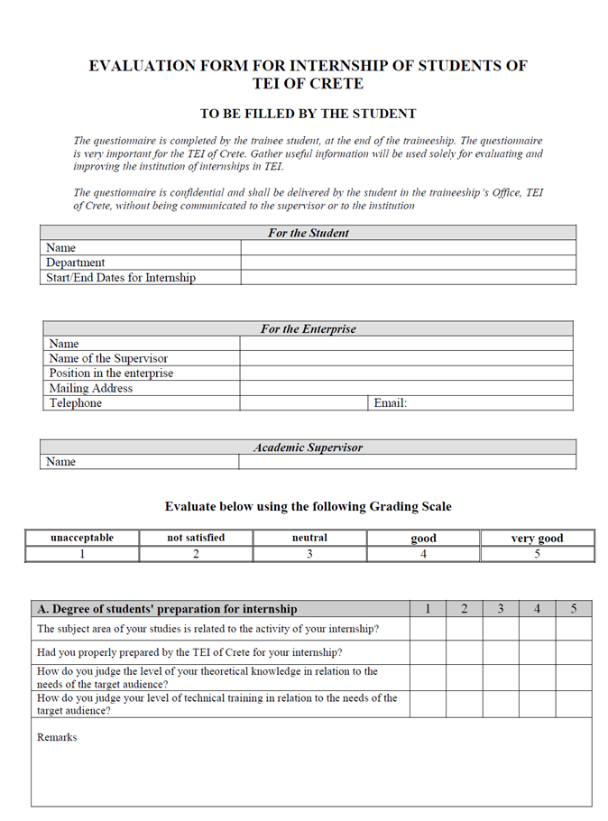
Similar questionnaires are given to be fulfilled from the supervisors.

Slide 17
It’s a need for engineering education to redesign the curricula because the last decade there is a major shift of demand of qualified engineers in new technologies
Along the on-campus approaches followed by HEIs (capstone design courses, first-year or cornerstone engineering design courses, incorporation of engineering design issues in the somophore and junior years), it is evident that the off-campus WPL of students during the internship period presents an additional tool.

Slide 18
Students’ internships may definitely be regarded as a means of quality enhancement for both HEIs and individual academics.
Thus, potential benefits of internships include useful feedback for curriculum design and modifications, the enrichment of on-campus learning with trustworthy real life examples, as well as the establishment of closer links for research and development purposes.

Slide 19
Perception of the academic supervisors about the HE’s suitability, correspondence and compliance

Slide 20
Conclusions and further directions
It is widely accepted that European education and training systems continue to fall short in providing the right skills for employability, and are not working adequately with business or employers to bring the learning experience closer to the reality of the working environment.
The survey data with the corresponding QPIs presented in Sections 2 and 3 provide a clear indication that internships can facilitate “competence-based education” and support “student-centered learning”.
Taking into account that these skills mismatches are a growing concern for a country’s competitiveness, we include the enterprises’ opinion to reform our curricula.

Slide 21
Conclusions and further directions
We have also adopted a Web 2.0-supported framework for the WPL of our electronic engineering students.
Our approach regarding internships (the establishment of connections with prHEs and puHEs, monitoring of students’ learning, quality assessment, etc.) is in line with current EU initiatives, such as the “Rethinking Education initiative”
We have to go further using more data and have a comparison between similar departments and similar enterprises

Slide 22
Acknowledgments
This work was co-financed by the European Social Fund and Hellenic Ministry of Education and Religious Affairs in the framework of the Operational Programme for Education and Lifelong Learning and the authors would like to thanks them
We would like also to express our sincerely thanks to PRAXIS Network, the organisation committee and our Institution for their multilevel support

Slide 23

Thank you for your attendance

