Slide 1
“University Industry cooperation: TICASS regional innovation hub approach”
Gustavo Capannelli
TICASS’s President
PRAXIS Conference
Genova 25-26 September 2014

Slide 2
TICASS Regional innovation hub
TICASS – acronym for Innovative Technologies for Environmental Control and Sustainable Development - is a non-profit Consortium established in March 2010, composed of research authorities and large, medium and small companies.
TICASS performs, promotes and enhances research activities, as well as transferring excellence technologies in the "Energy and Environment" area with regards to Sustainable Development and Quality of Life.
The consortium role is also the coordination of the above mentioned activities at regional, national and international level. Its main goal is to widen knowledge and introduce innovative technologies by the cross-border cooperation, with universities and other public and private bodies.

Slide 3
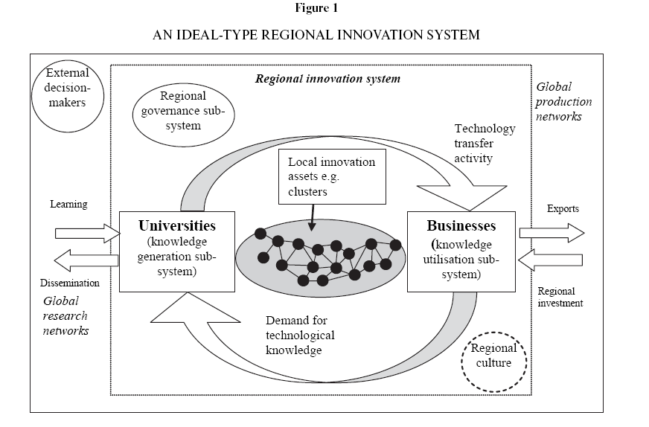
About Genova
Source: Cooke & Piccaluga, 2004

Slide 4
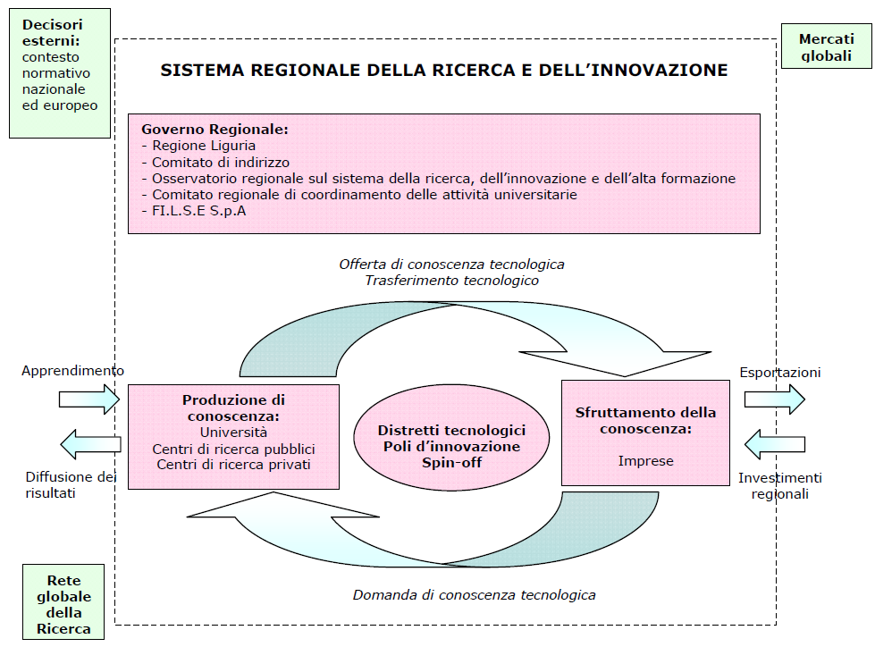
Regional Innovation System
Smart Specialization Strategy
Source: Regione Liguria

Slide 5
TICASS Regional Research and
Innovation Hub…..
Ticass is a non-profit Consortium including public research bodies (Departments of the University of Genoa), SME's and large Companies. It is the core of the regional Innovation Hub "Energy and Environment" supported by ERDF in the Liguria Region in Italy. Ticass is finalized to carry out, promote, diffuse, transfer and exploit research and innovative technologies for:
- Energy Saving
- Environmental Control and Management
- Sustainable Development
- Improvement of Life Quality

Slide 6
……TICASS Regional Research and Innovation Hub
⬇ 9 Research Department belonging to the University of Genova:
Department of Chemistry and Industrial Chemistry; Department of Civil chemical and Environmental Engineering; Department of Physics; Mechanical Industrial Management Energy Environment and Transport Engineering; Department for the Study of the Territory and its resources; Department of Experimental Medicine; Department of Informatics, Bioengineering, Robotics and Information Science; Department of Sciences for Architecture; Department of Naval Architecture and Marine Engineering
⬇ Italian Institute for Nuclear Physics (INFN - Research Area of Genova)
⬇ 42 Companies

Slide 7
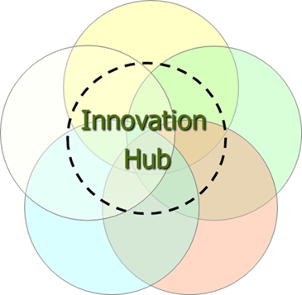
SMALL companie
INDUSTRIA AMBIENTE
Active Cells
ITEC
ANALISI e CONTROLLI
ANTEA
LARGE companies
GIS & WEB
SERVIZI ECOLOGICI
EUROCHEM
MEDIUM Ccompanies
SIIT/PMI
GISIG
Biotec Sistemi
IREOS LABORATORI
CPG
Muvita
P & T
SIGE
BOERO
PM Ten
Micamo
SANTORO
IREOS
SEPG
ARCADIA
ITALIANA COKE
FONDAZ. CIMA
FONDAZ. AMGA
ISTITUTO ITALIANO SALDATURA
IPLOM
IRENAcqua Gas
A&A F.llI PARODI
FACI
CAP
UNIVERSITA’ DEGLI STUDI DI GENOVA;
CNR; INFN

Slide 8
Ticass activities:
Research & Development: European, national and regional research projects;
Training: University master, Life long training, professional courses, Tempus, Erasmus + projects;
Technology transfer: conversion adaptation and exploitation of research’s outcomes to match concrete industrial requirements and to solve technical and production issues
Support to local policy makers: collection of inputs from local system of production (paying special attention to SME’s)
Networking: members of two National technological Clusters, European technology platform for water….

Slide 9
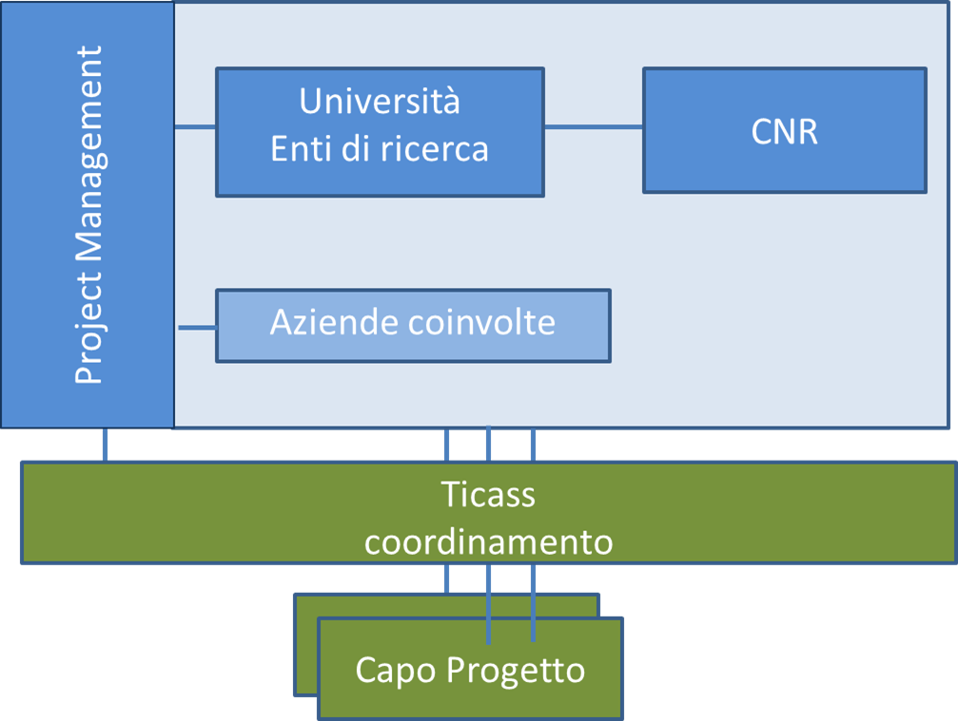
How do we do, Ticass’s approach:
Market driven approach;
Early involvement of companies and SMEs to collect industrial inputs;
Interdisciplinary approach to supply a complete useful answer to concrete problems;
Open access to competences and skills of the University of Genova and National Research Council;
Development of multidisciplinary and culturally diverse work team specifically targeted for each project;
Support the interaction and relationship development between University and Industry;
Development of organizational tool to foster technology transfer and trust generation.

Slide 10

Experience in the Training field
Post graduate training;
European projects (Netwater, GreenMA, GeoSmartCity…);
Research Grants (coordination of 11 research grants, involving 22 companies, of which 10 SMEs);
Scouting regarding instruments, incentives and concessions supporting work placement.

Slide 11
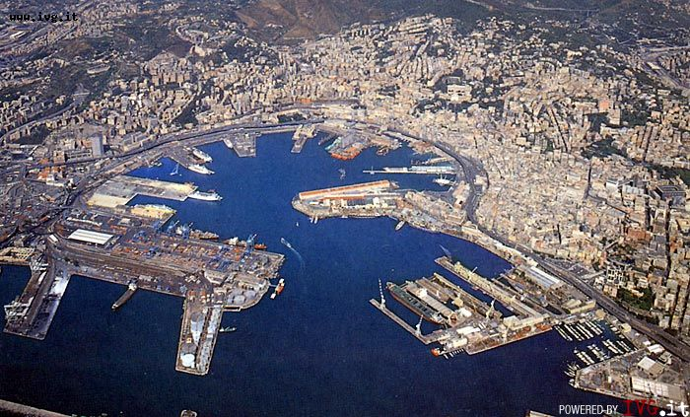
Thank you for your attention
For more information
www.ticass.it

Slide 12
Post graduate training
Water Treatment;
Environmental monitoring;
Registration, Evaluation, Authorisation and Restriction of Chemicals REACH;
Master in Advanced Welding Engineering MAWE;
Intensive course for Russian junior staff in «Energy saving for Environmental Protection and Control“;
Training in Technologies of Water Resources Management

Slide 13

Research Grants

