Slide 1
Ansaldo Energia experience with PhD, Research Fellowship and Apprenticeship for higher education

Slide 2
FRAMEWORK
Ansaldo Energia is Italy’s largest supplier, installer and service provider for power generation plants and components and one of the world’s leading players in the sector.
2700 workers employed

Slide 3
FRAMEWORK
2010-2013 72 new people were hired on average every year
35% of them are <30
33% have a High school diploma
43% have a University degree

Slide 4
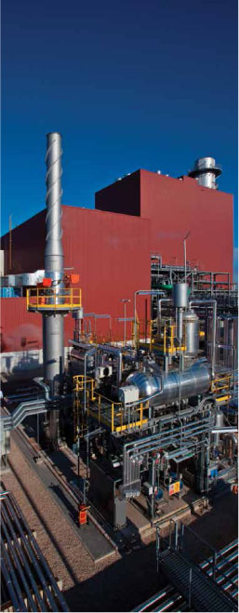
FRAMEWORK
School degree variation 2004-2014

Slide 5
PHD AND RESEARCH FELLOWSHIP
Ansaldo Energia has always developed technical and R&D projects in cooperation with Italian and foreign Universities, aiming to the best possible integration between study and job
Phd and Research fellowship programs

Slide 6
PHD AND RESEARCH FELLOWSHIP
Why
Teamwork between Ansaldo Energia and University for the development of know how and know why
What
Engineering activities where melting of academic and company knowledge is needed
How
Phd students and Research fellows spend their time both in Ansaldo Energia and University
Where
Technical departments (R&D, Engineering, Service, Quality control…)
How many
2013-2014 7 projects every year

Slide 7
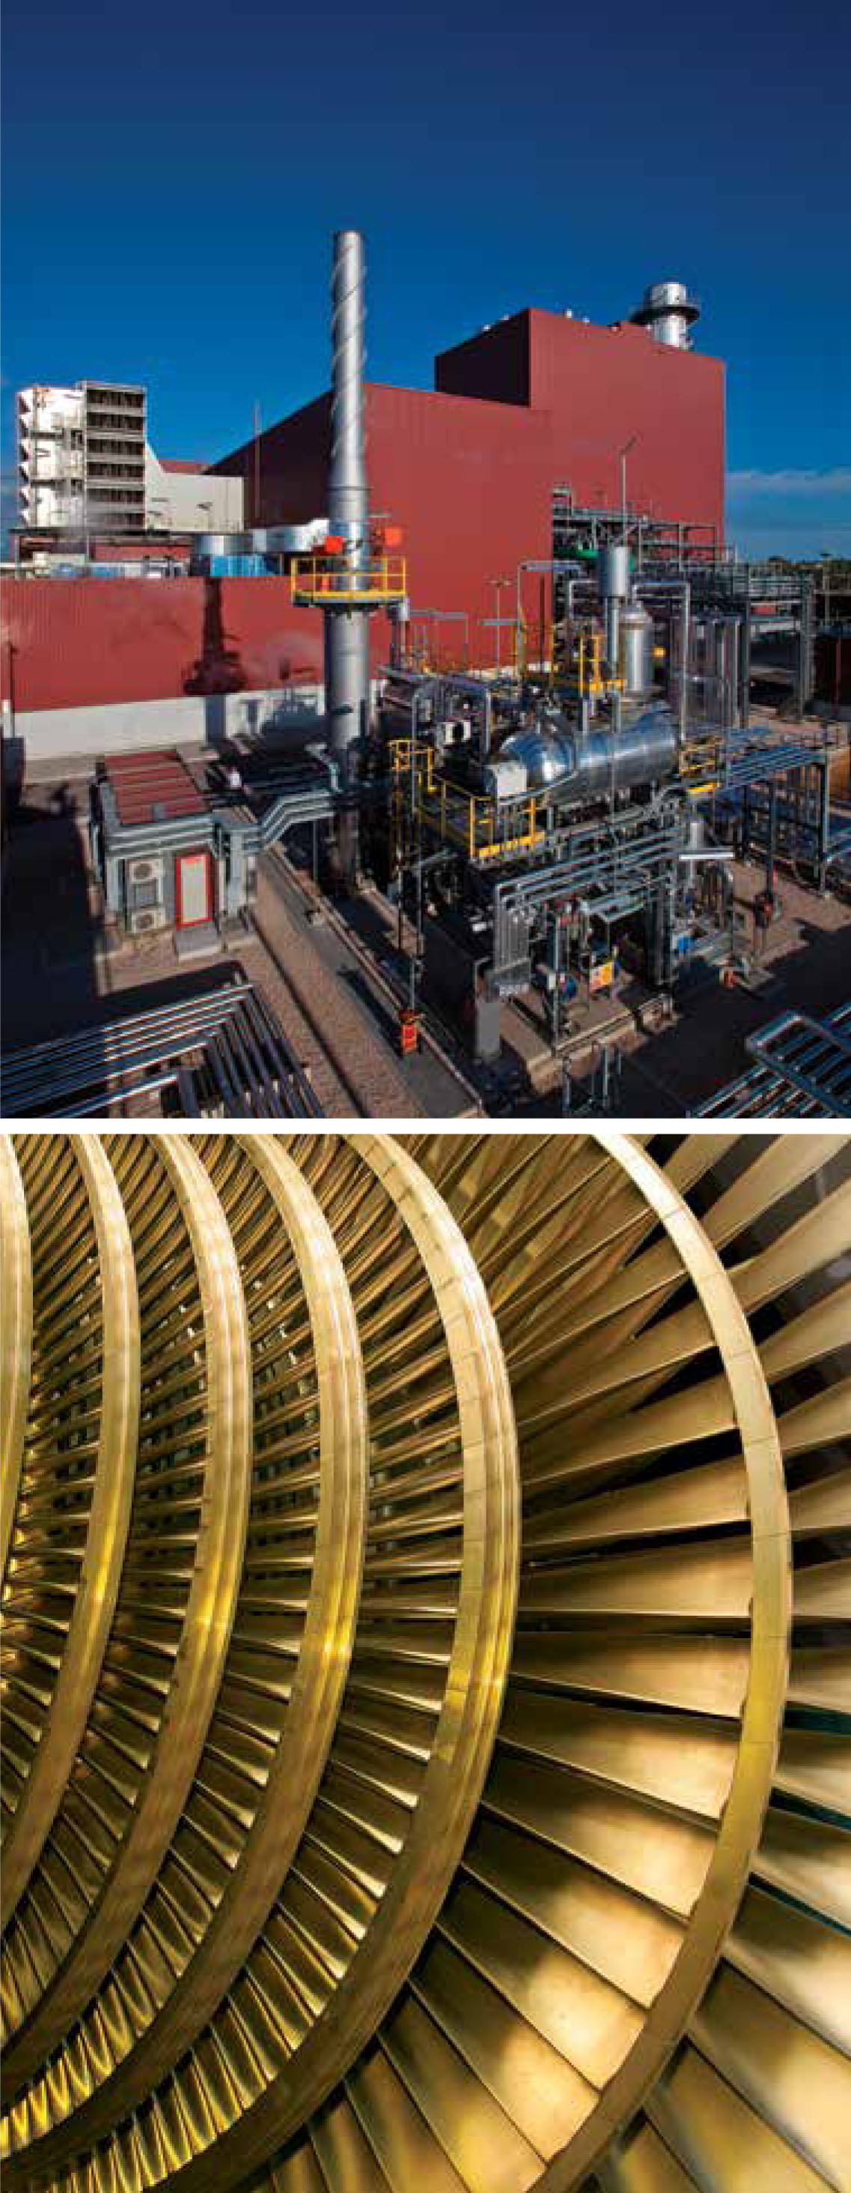
HIGHER EDUCATION AND RESEARCH APPRENTICESHIP
Ansaldo Energia has successfully used professional training apprenticeship and financed training in order to engage skilled young people, with focused training for production jobs
Higher Education apprenticeship
Research apprenticeship

Slide 8
HIGHER EDUCATION APPRENTICESHIP
Why
To attract young talents and to draw a tailored, high level and integrated training program, melting the best from academic and business knowledge
What
2007/2009 Master Degree in Engineering with a specific focus on Power Generation
2009/2011 Master Degree in Innovation and Product development for Power Generation
How
about 800 hours training (50% off the job, 50% on the job)
50% of the lectures were held by University Professors and external experts, 50% were held by Ansaldo Energia workers
Where
Operations and Engineering, Research and Development
How many
44 people involved

Slide 9
RESEARCH APPRENTICESHIP
Why
To attract young talents and focus on research activities
To build a tie between academic knowledge and technical knowhow
What
Research projects for R&D
How
Young engineers have been hired for two years to follow a research project
On the job training and monitoring allow the trainee to develop their competencies
Where
R&D department
How many
6 people involved

Slide 10
RESEARCH APPRENTICESHIP
Engineering degree
Individual Research project
Expected competencies
Technical skills Research activities Soft skills
Skill development is regularly monitored through an assessment and self assessment process
Research final Project work

Slide 11
TUTORSHIP
Academic tutors are involved on
Support to the apprentice in his Research job
Tie academic knowledge and on the job training
Company tutors were asked to accept this role and are involved on:
Definition of the skill set for each job position
Supervising students on the job induction
Initial, in progress and final assessment of both technical and soft skills
Company tutors have attended a specific training about assessment issues Great opportunity for growth

Slide 12
Thank you

