Slide 1
PRAXIS Forum 2014
Project Work and Internship: impacts on labor market and society
Societal Challenges in the Focus of ICT Research and Innovation: opportunities for young professionals
József Györkös
University of Maribor, Faculty of Electrical Engineering and Computer Science, professor
CONNECT Advisory Forum for Research and Innovation in ICT, chair
PRAXIS Forum, 25. September 2014

Slide 2

CONNECT Advisory Forum for ICT Research and Innovation (CAF)
Mandate: to give consistent and consolidated advice to the Commission services during the preparation of the Horizon 2020 work programme, regarding the relevant challenge/part of the Specific Programme. Advice should be provided on relevant objectives and scientific, technological and innovation priorities.
The CAF's role:
to advise on safeguarding the linkages and coherence of ICT across all the three priorities of H2020: "scientific excellence', "industrial leadership" and "societal challenges”,
to bring the ICT research & innovation closer to the potential users.
to support outreach and dialogue with a wider group of stakeholders.
Members (selection based on the call on 14th September 2012) >:
27 (call-related) + 5 (nominated by commissionaire)
PRAXIS Forum, 25. September 2014

Slide 3
Industrial Leadership:
1) Components and Systems
2) Next generation computing
3) Future Internet, network infrastructures and cloud computing
4) Digital content
5) Robotics
6) Micro and nano-electronics, Photonics
CAF is primarily focused in the ICT theme under the
(a) industrial leadership in enabling technologies (LEIT-ICT) priority of Horizon 2020 and also the contribution of ICT to the
(b) 7 societal challenges that are part of the final version of Horizon 2020 and
(c) on the role of innovation as a central and cross cutting dimension of Horizon 2020.
In June 2013 (d) Internet of Things (IoT) stakeholder group was established.
Ongoing task:
Horizon 2020 Research Beyond 2015
PRAXIS Forum, 25. September 2014

Slide 4

Cross – cutting activities?
!
Well known illustration from European Commission, introductory documnets for H2020
Europe 2020 priorities
Shared objectives and principles
Tackling Societal Challenges
  Health, demographic change and wellbeing
  Food security, sustainable agriculture and
  the bio-based economy
  Secure, clean and efficient energy
  Smart, green and integrated transport
  Climate action, resource efficiency and raw
  materials
  Inclusive, innovative and reflective societies
  Secure Societies
Creating Industrial Leadership and Competitive Frameworks
Leadership in enabling and industrial technologies
  ICT
  Nanotech., Materials, Manuf. and Processing
  Biotechnology
  Space
Access to risk finance
Innovation in SMEs
ICT
ICT
ICT
ICT
ICT
ICT
ICT
EIT
JRC
Excellence in the Science Base
Frontier research (ERC)
Future and Emerging Technologies (FET)
Skills and career development (Marie Curie)
Research infrastructures
ICT
ICT
Simplified access
Common rules, toolkit of funding schemes
Dissemination & knowledge tranfer
PRAXIS Forum, 25. September 2014

Slide 5
Cont. Cross–cutting activities and Internet of Things (IoT)
“The most profound technologies are those that disappear.
They weave themselves into the fabric of everyday life until they are indistinguishable from it.”
Dr. Mark Weiser, “father of ubiquitous computing”
Definition of IoT by ITU (ITU-T Y.2069)
“… a global infrastructure for the Information Society, enabling advanced services by interconnecting (physical and virtual) things based on, existing and evolving, interoperable information and communication technologies.”
PRAXIS Forum, 25. September 2014

Slide 6
Hyper scalability
IoT flavoured
Technology is an important enabler, but
the really disruptive effect results from the "hyper-scalability" effect of "data" applications – where adoption by user communities is the determining factor for success.
The penetration of internet
will increase in scope and depth due to IoT. Not only will new application fields be opened up, but also the penetration of processes, environments and actions by ICT will increase.
The range of “things”
that will be sensed, tracked, and manipulated through IoT will be overwhelming, spanning from microscopic and even sub-microscopic entities (bacteria, nanobots, etc.) to macroscopic objects. The digital shadows of these “things”, the ‘data’ will be very different, and what constitutes “things” will also depend on the context.
PRAXIS Forum, 25. September 2014

Slide 7
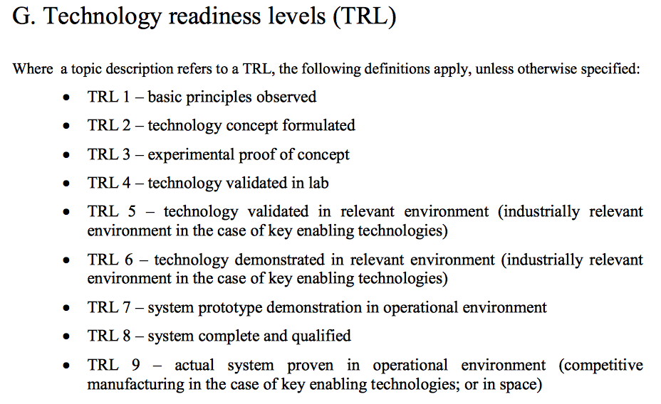
MARLSs instead of TRLs?
Source: HORIZON 2020 – WORK PROGRAMME 2014-2015; General Annexes
PRAXIS Forum, 25. September 2014

Slide 8
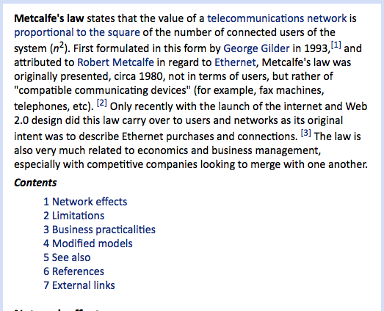
Hot topic: Maximize the effect of Metcalf’s Law
IoT flavoured
Metcalfe’s law is an intrinsic aspect of the IoT world,
referring to hyper scalability, needs to be fully exploited to maximize the effect of the IoT.
It implies in business organizations in re-definition of their business model putting more emphasis on the services associated to hyper-scalability and connectability.
Source: princeton.edu
(Gilder/Metcalfe, 1993)

Slide 9
MARLSs instead of TRLs?
The traditional techno-centric discourse largely relies on the concept of TRL. One of the proposed models/alternative: "market adoption readiness levels" (MARLs).
IoT applications require the development along a different dimension including: adequate business models, the user point of view, societal aspects.
Additional MARL parameters (to the TRLs):
users (numbers of potential early adopters and values associated with feedback loops), data (potential quantity and value of data generated by the system and user interactions at each stage of the process) and the level of risk (assessment of benefits or adverse/harmful impacts of the technology on early adopters in various stages of the process).
The fact: low-risk technologies can capture large numbers of early adopters, thus generating valuable data and creating a creative cycle of self-reinforcement.
PRAXIS Forum, 25. September 2014

Slide 10
Research potentials
in the light of presented trends and challenges
focusing on project work and internship / impacts on labour market and society:
I/H* 1: How a demanding technological expert area should be melted with requirements of cross-cutting societal aspects of implementation.
I/H 2: Technology readiness levels need to be examined from the aspect of young experts involvement.
I/H 3: Elements of Market adoption readiness levels should be investigated and methodologies need to be formulated considering the impact of hyper-scalability, early adopters foresight and the level of risk.
* Idea or hint that should be formulated as a research question.
PRAXIS Forum, 25. September 2014

Slide 11
Food for thought
The European Digital Agenda is heavily focused on new jobs and employability.
ICT job related opportunities are - besides expert knowledge obtained from the education system - related to individual’s affinity, the individual’s capability of (cyber) social skills and sensitivity for cross-cutting potentials of ICT.
Societal Challenges in the Focus of ICT Research and Innovation: opportunities for young professionals,
József Györkös
PRAXIS Forum, 25. September 2014
11

