Slide 1



Usage
Nuno Escudeiro – ISEP Porto – nfe@isep.ipp.pt
27.09.14
- Meeting M7
Genova, September 2014

Slide 2
- Meeting M7
Genova, September 2014
Usage stats

Slide 3
- Meeting M7
Genova, September 2014
Usage stats
Registered Providers | 134
Registered Students | 387
Traded offers | 199

Slide 4

- Meeting M7
Genova, September 2014
In the pipeline

Slide 5
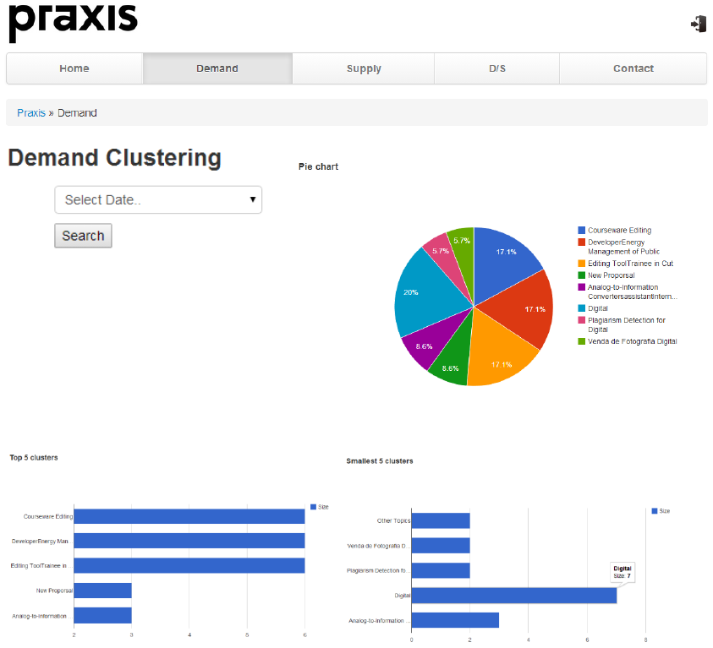
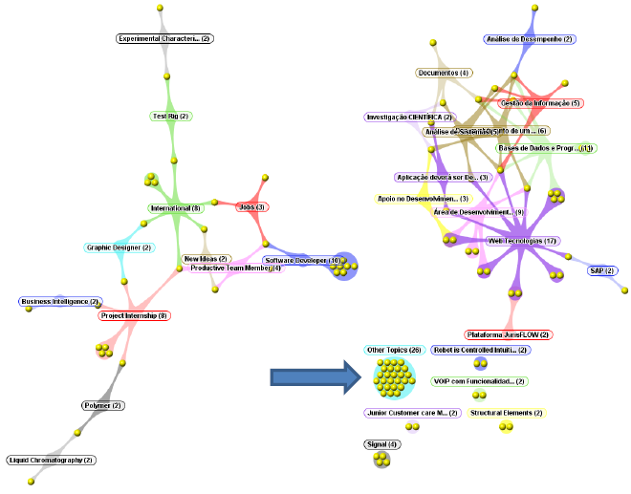
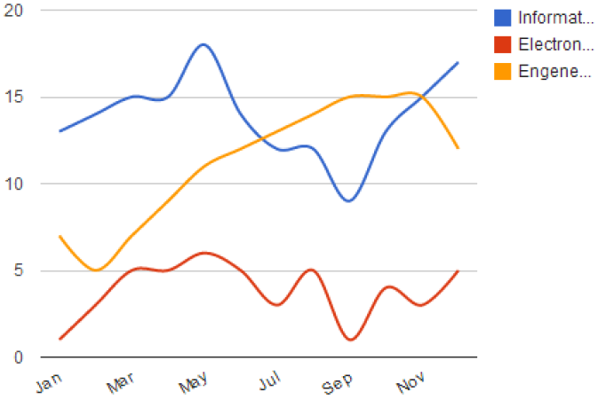
- Meeting M7
Genova, September 2014
Coming soon
Market Gap Analysis

Slide 6
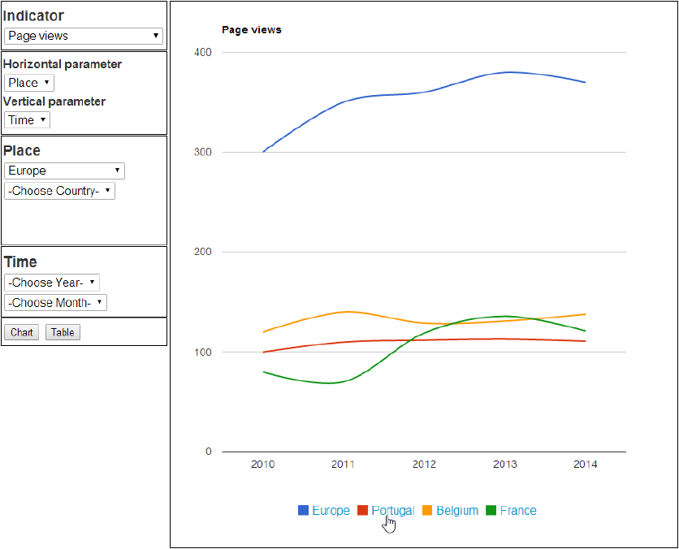
- Meeting M7
Genova, September 2014
Coming soon
Market Gap Analysis
Mobility Observatory

Slide 7
- Meeting M7
Genova, September 2014
Coming soon
Market Gap Analysis
Mobility Observatory
Periodic reports to EC
Offer log-book for students and providers
Providers and HEI Rankings
...

Slide 8


I
www.praxisnetwork.eu

